Slide 1












Aquamarine
Kelompok 6 :
Fundroo Orlando - 535200074
Gloria Valerie Lao - 535200049
Michelle Augustine - 535200055
Tiffany - 535200057
Stevenson Tjuaca- 535200067

Slide 2



01
Fitur dan Layout

Slide 3

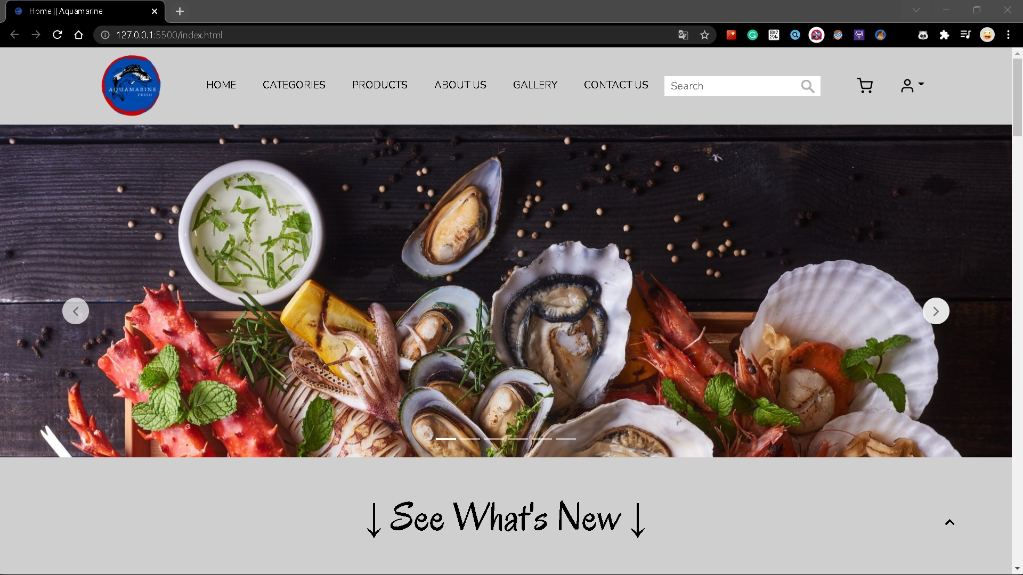
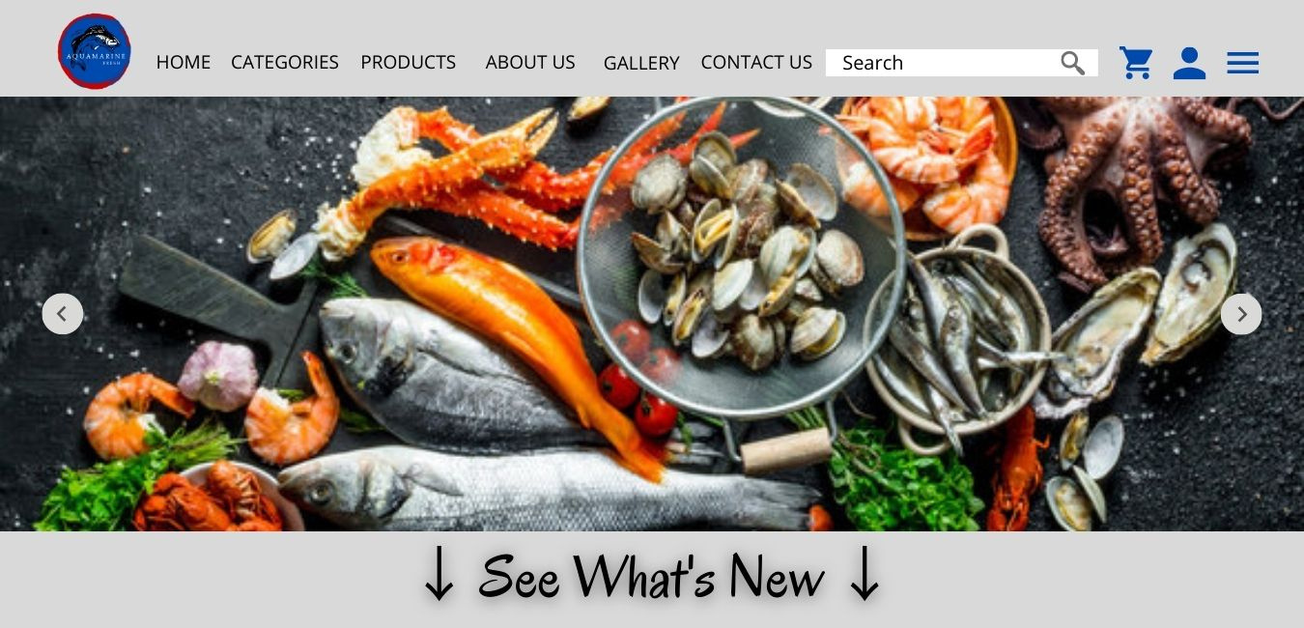
Halaman Home
Design
Web
Warna icon Cart dan Profile ganti dari biru jadi hitam
Pada Carousel ada tambahan yaitu terdapat 6 garis dibawah

Slide 4


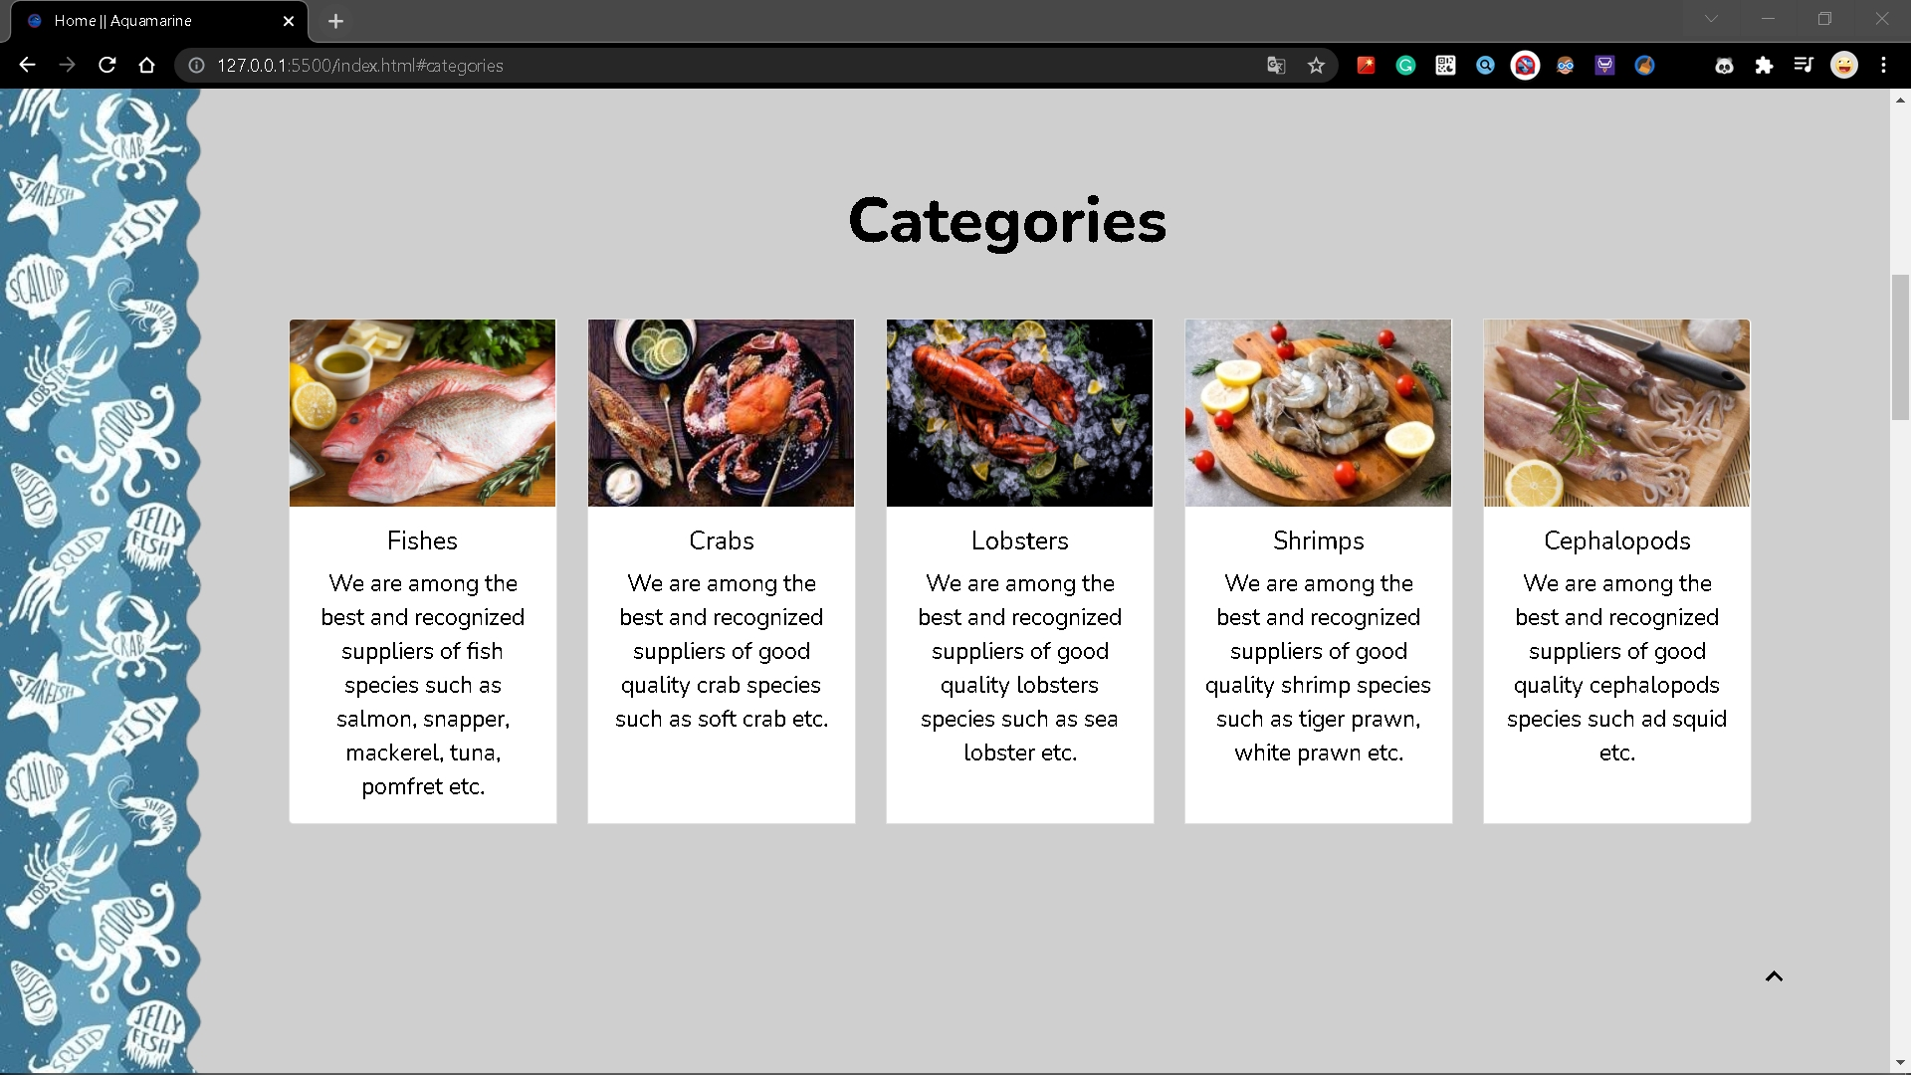
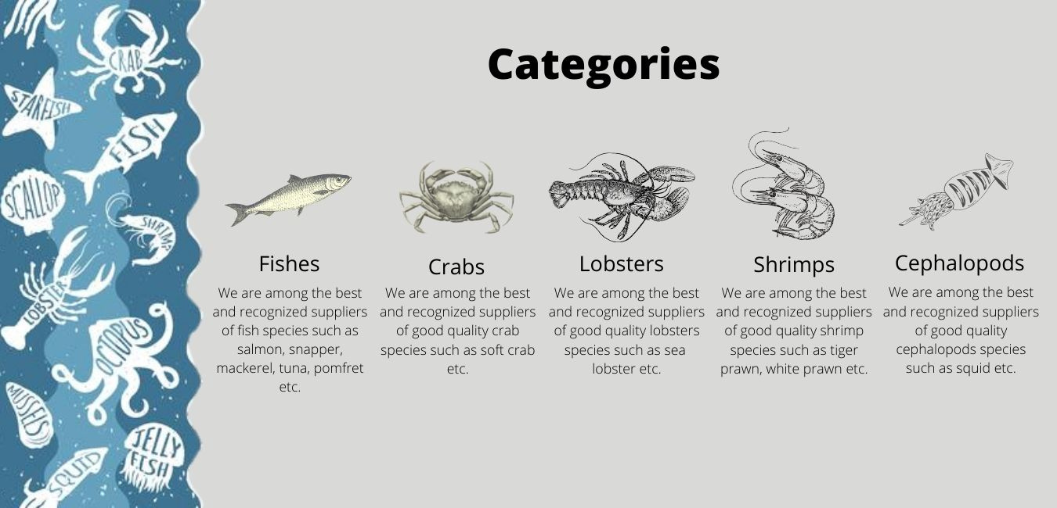
Halaman Categories
Design
Web
Beda layoutnya dengan design : ditambahkan box
Beda gambarnya dengan design : menggunakan gambar asli lebih menarik

Slide 5

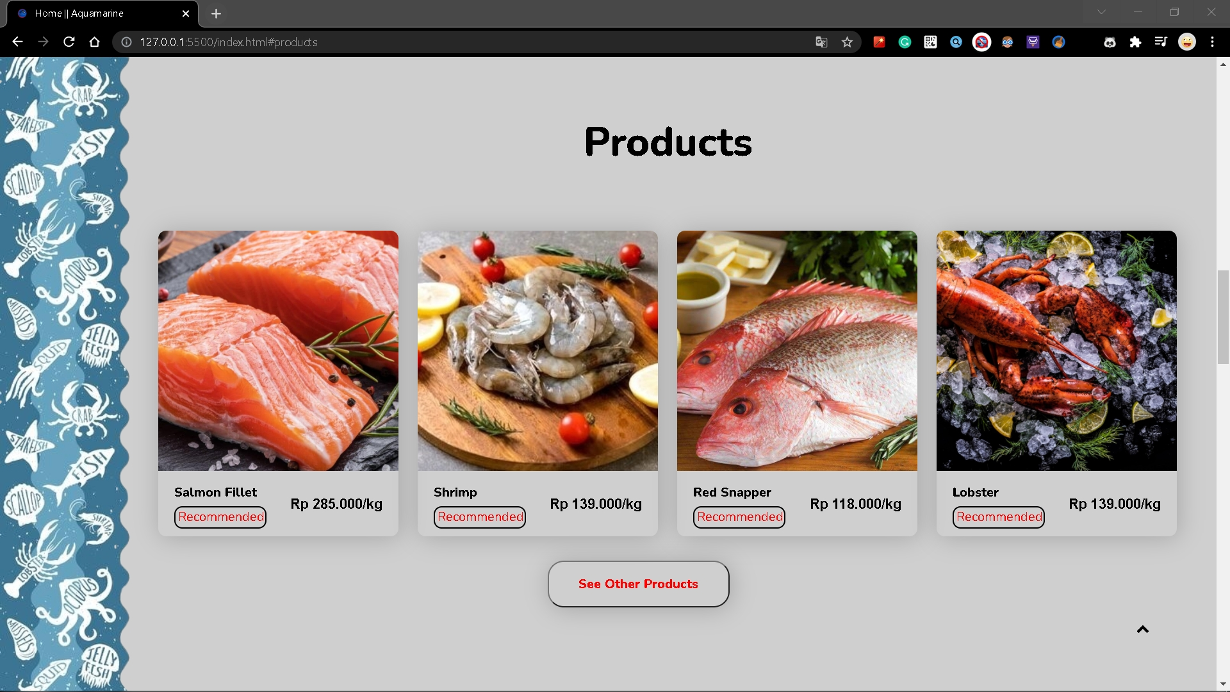
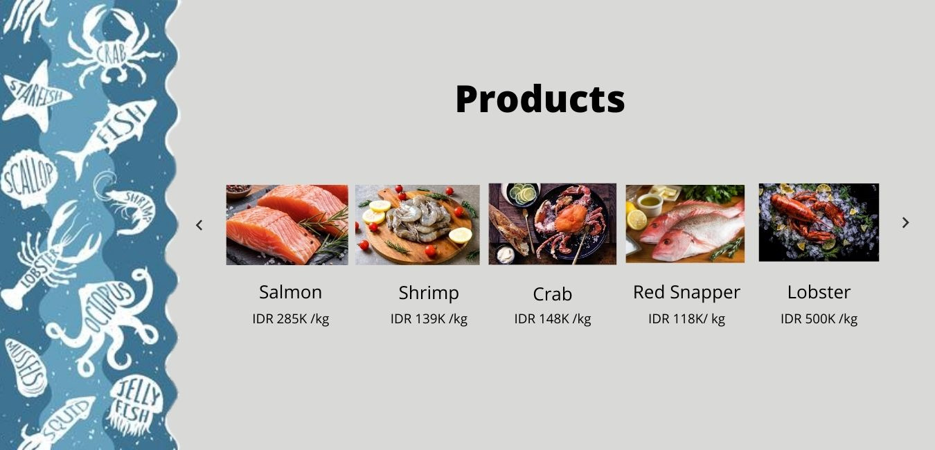
Halaman Products
Design
Web
Beda layoutnya dengan design : ditambahkan box dan gambar lebih besar
Menampilkan tulisan Recommended dari produk-produk yang ditampilkan
Carousel diganti dengan tambahan button See Other Products dibawah

Slide 6
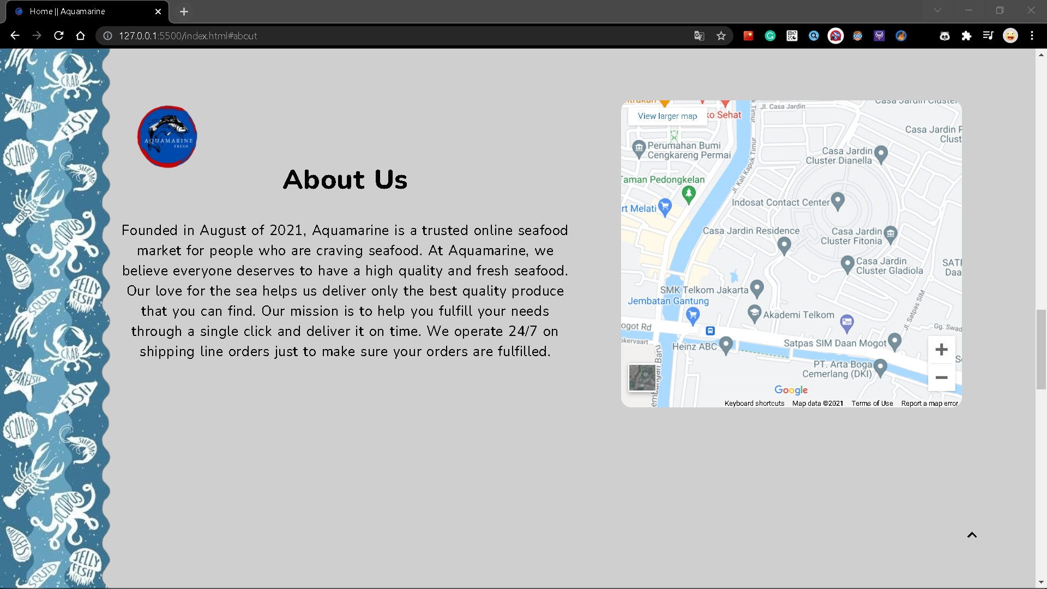
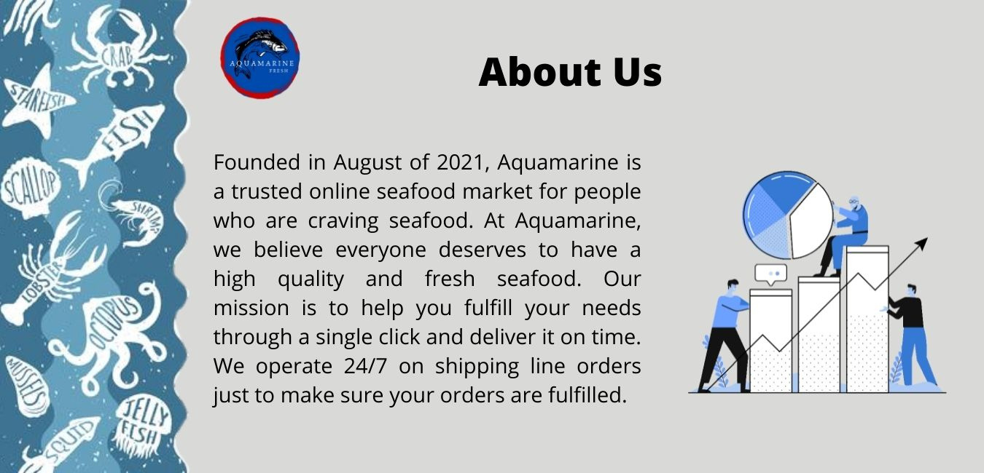
Halaman About Us
Design
Web
Letak judul berubah dari tengah ke kiri
Gambar pada design diganti dengan Location Map dari Lokasi Perusahaan

Slide 7
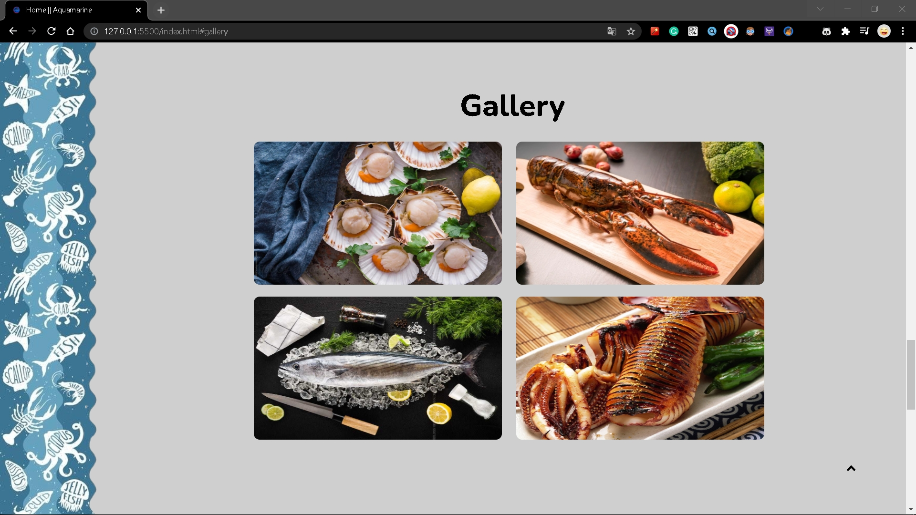

Halaman Gallery
Design
Web
Untuk gambarnya ada sedikit perubahan yaitu dari yang awalnya berjumlah 3 gambar menjadi 4 gambar
Ditambahkan sedikit border pada sudut gambar.

Slide 8
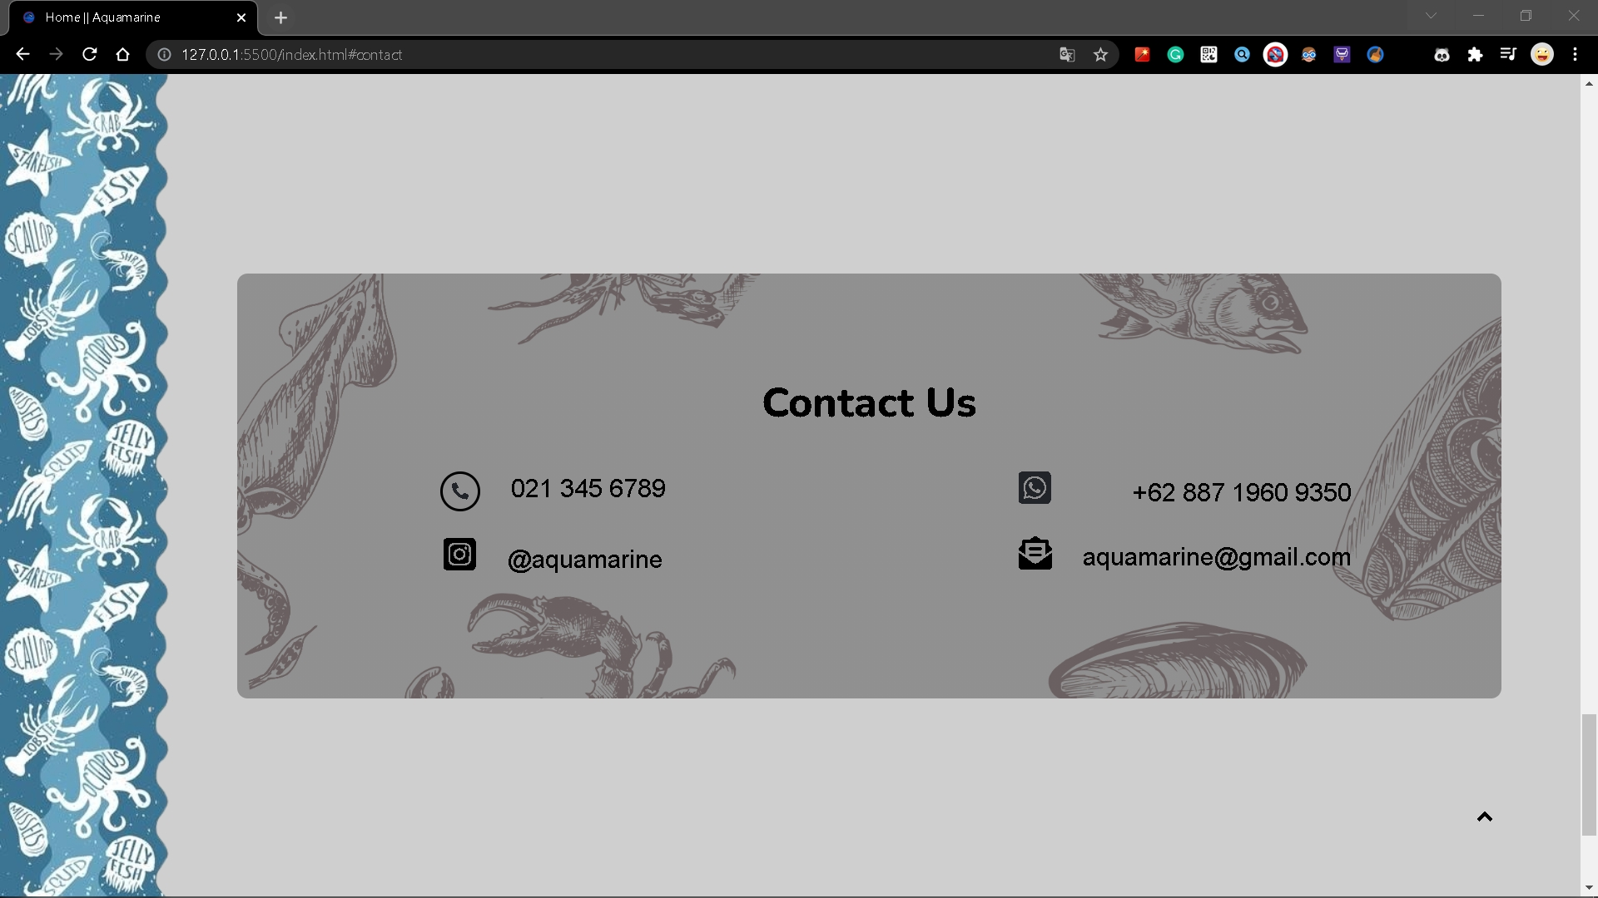


Halaman Contact Us
Design
Web
Beda layoutnya dengan design : ditambahkan box
Pada nomor WhatsApp, diganti dengan format +62

Slide 9
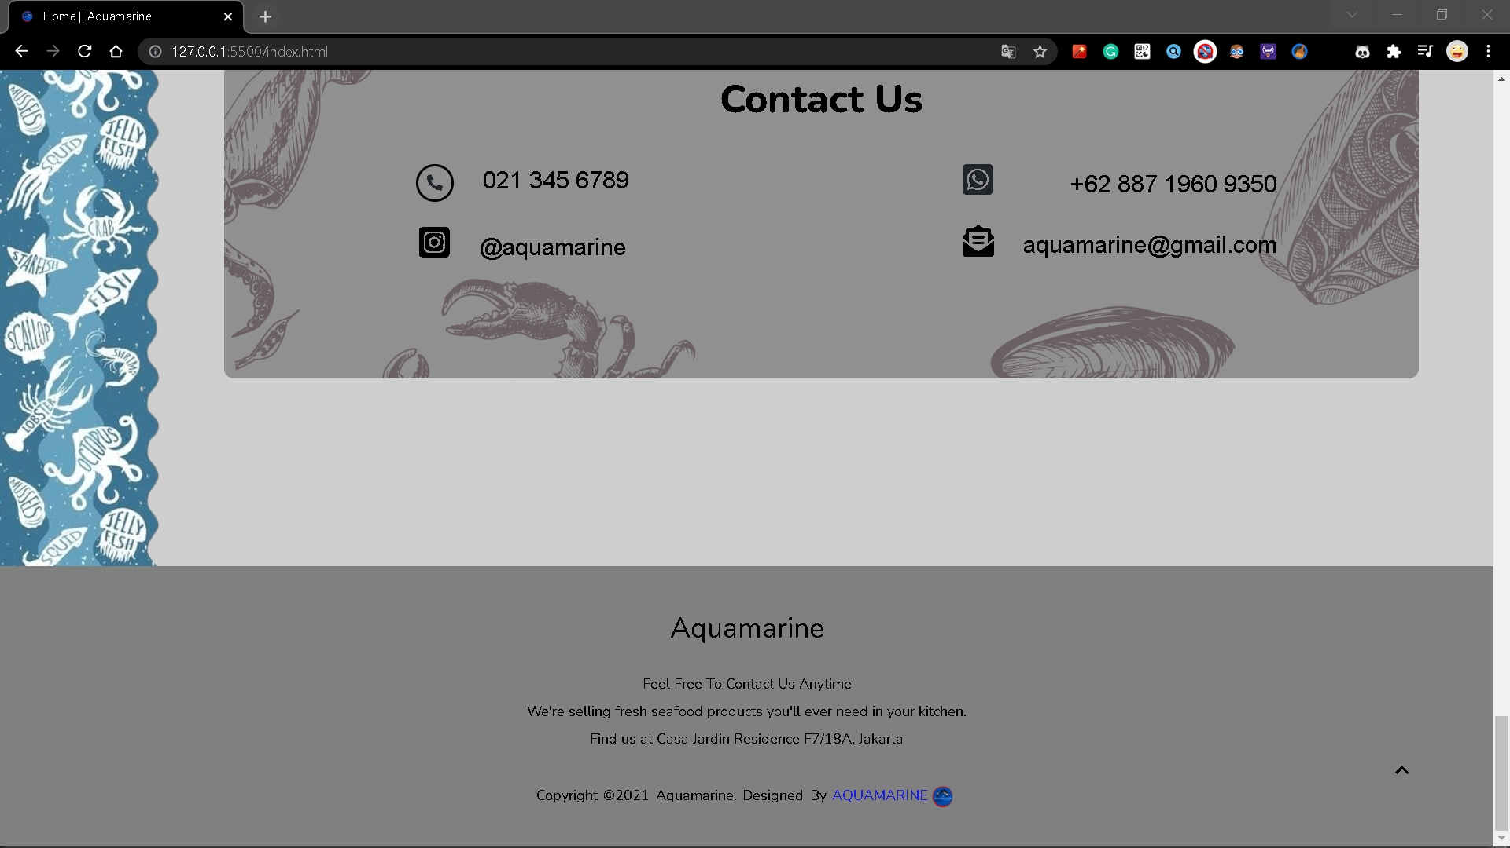
Halaman Footer

Slide 10
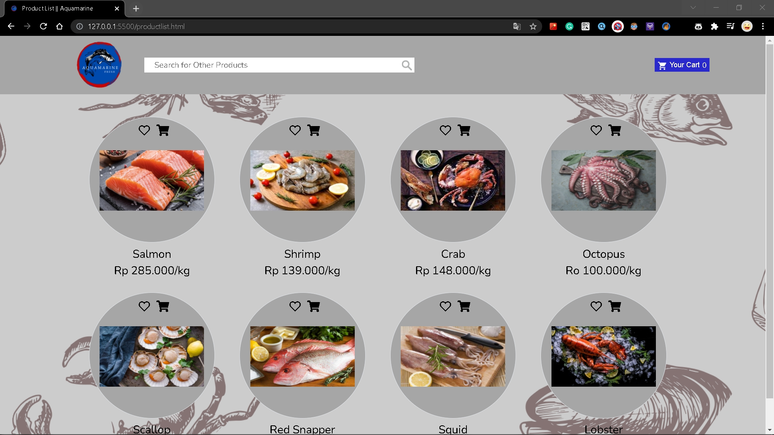
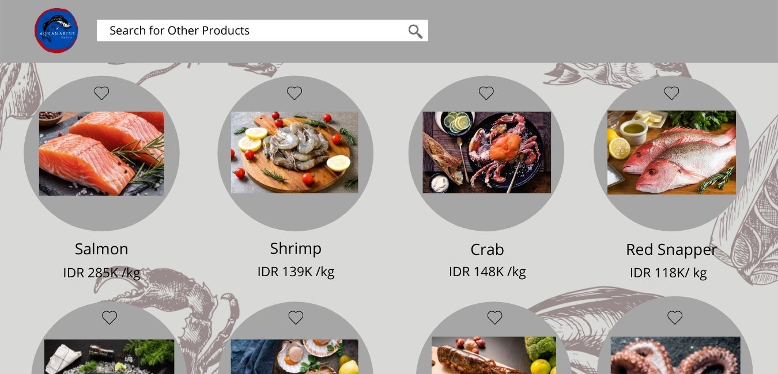
Halaman Products List
Design
Web
Tambah button Cart disebelah button Wish List
Tambah button Your Cart di sudut kanan

Slide 11
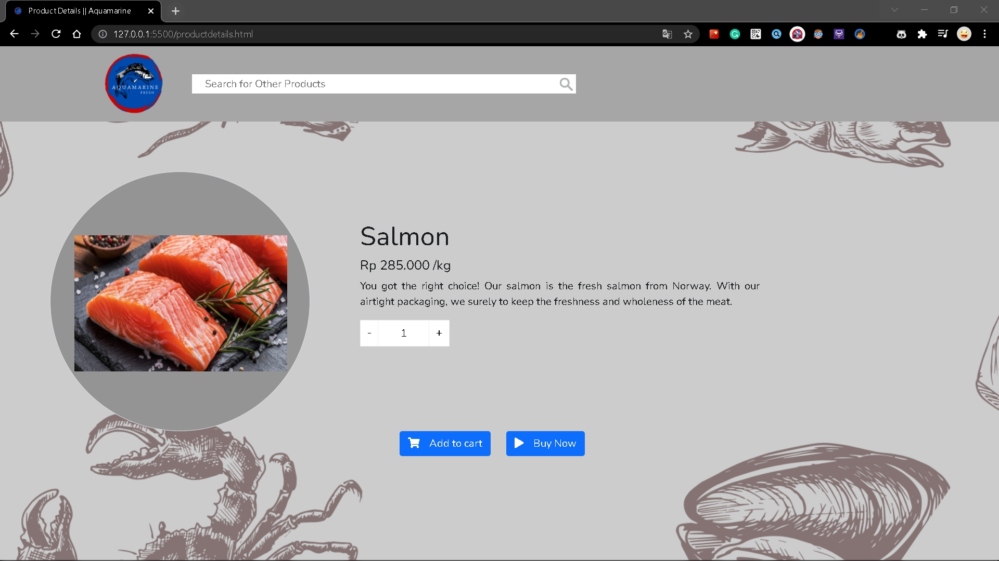
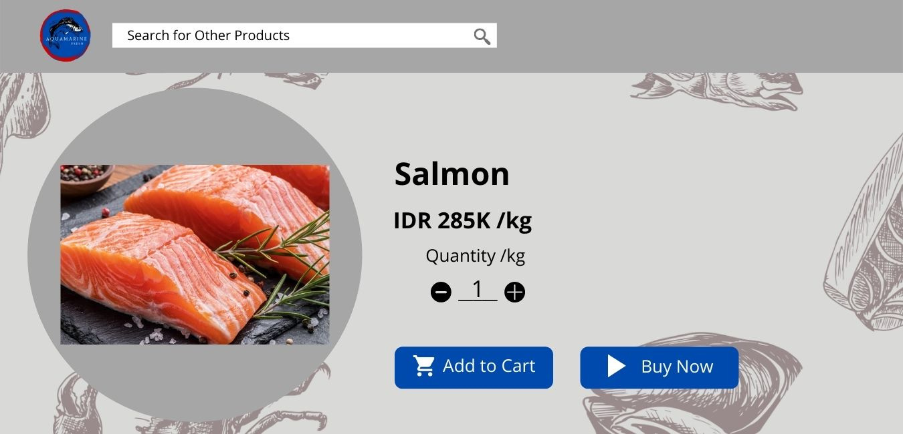
Halaman Product Details
Design
Web
Page setiap produk
Tambah deskripsi singkat mengenai produk
Bentuk dari - + beda dari design

Slide 12
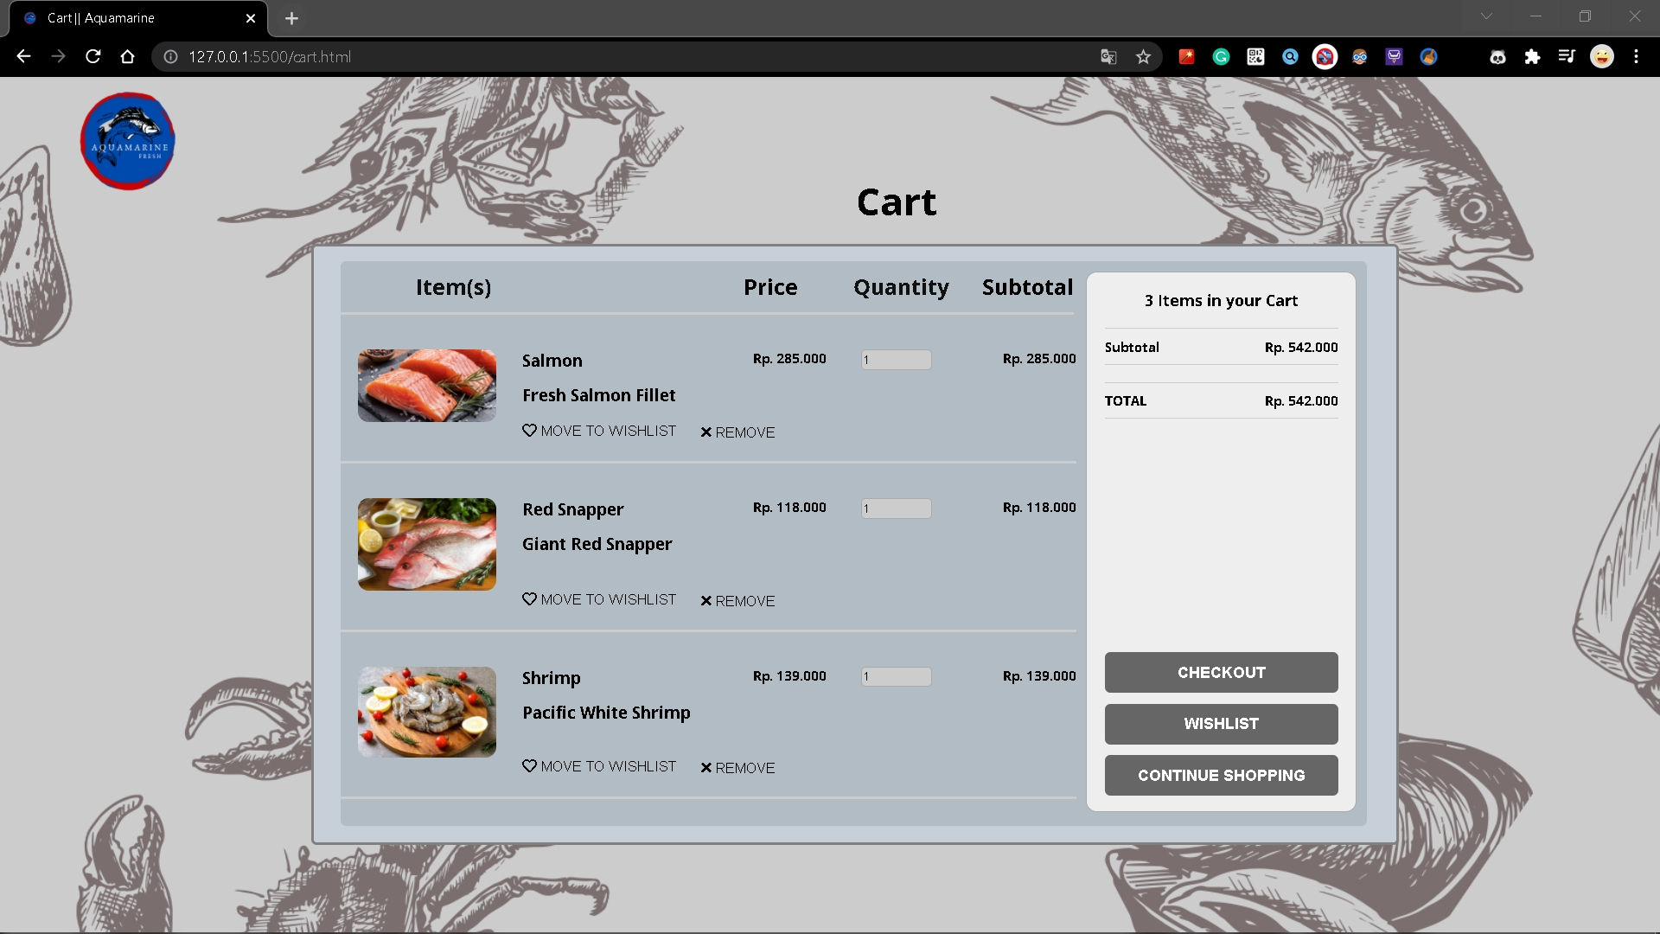
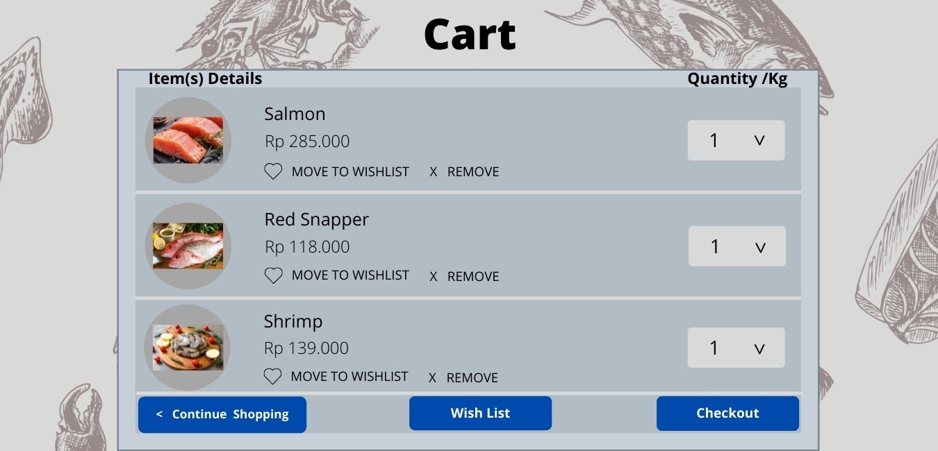
Halaman Cart
Design
Web
Terdapat logo dikiri atas
Tambah Subtotal dari harga masing-masing produk
Tambah deskripsi singkat dari produk
Quantity bisa di adjust naik (tambah), turun (kurang)
Tambah Box Item Total dikanan
Perpindahan letak button dari bawah ke samping

Slide 13


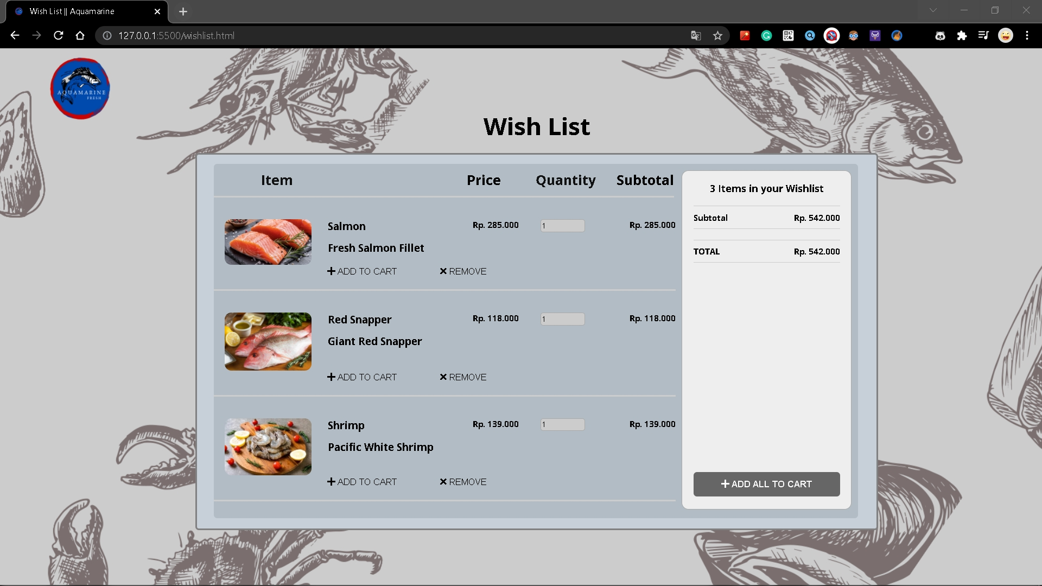
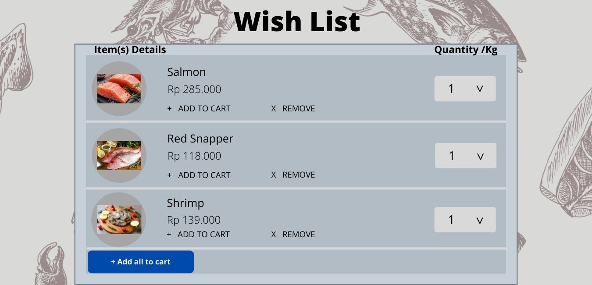
Halaman Wish List
Design
Web
Terdapat logo dikiri atas
Tambah Subtotal dari harga masing-masing produk
Tambah deskripsi singkat dari produk
Quantity bisa di adjust naik (tambah), turun (kurang)
Tambah Box Item Total dikanan
Perpindahan letak button dari bawah ke samping

Slide 14
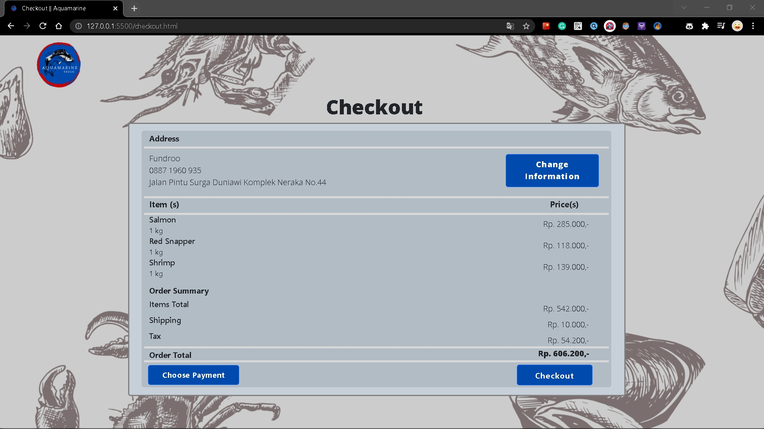
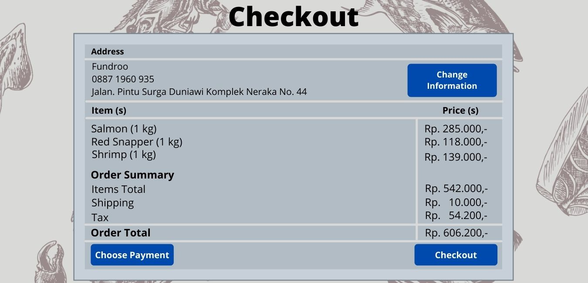
Halaman Checkout
Design
Web
Terdapat logo dikiri atas

Slide 15
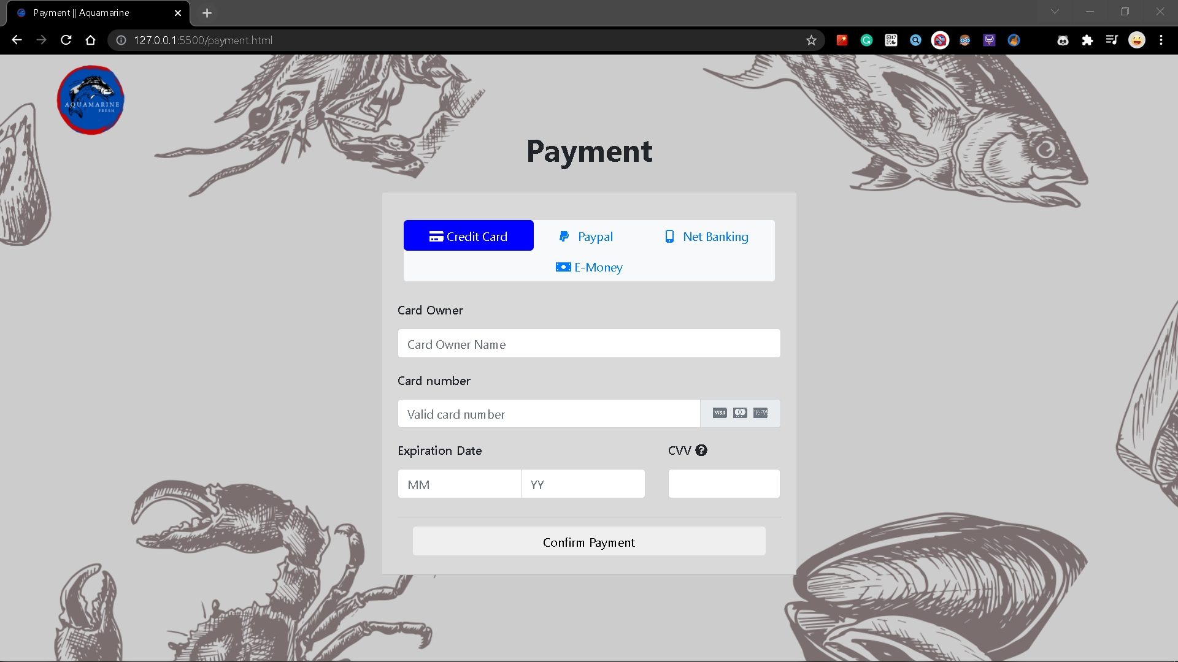
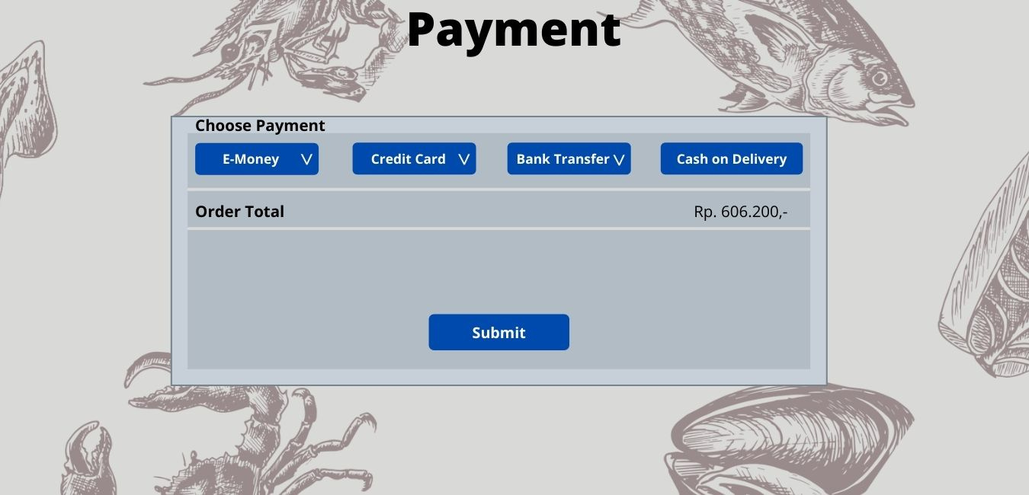
Halaman Payment
Design
Web
Terdapat logo dikiri atas
Terdapat perbedaan layout dengan design
Pada halaman awal sudah berada di pilihan Credit Card
Order total dihapus

Slide 16
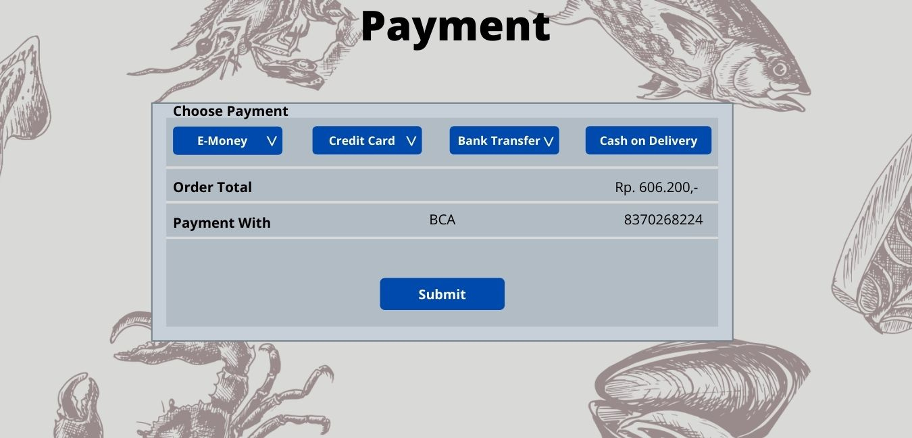
Halaman Payment Credit Card
Design
Web
Terdapat logo dikiri atas
Terdapat perbedaan layout dengan design
Order total dihapus
Langsung input data Credit Card dengan form yang tersedia
Button Submit diubah menjadi Confirm Payment

Slide 17
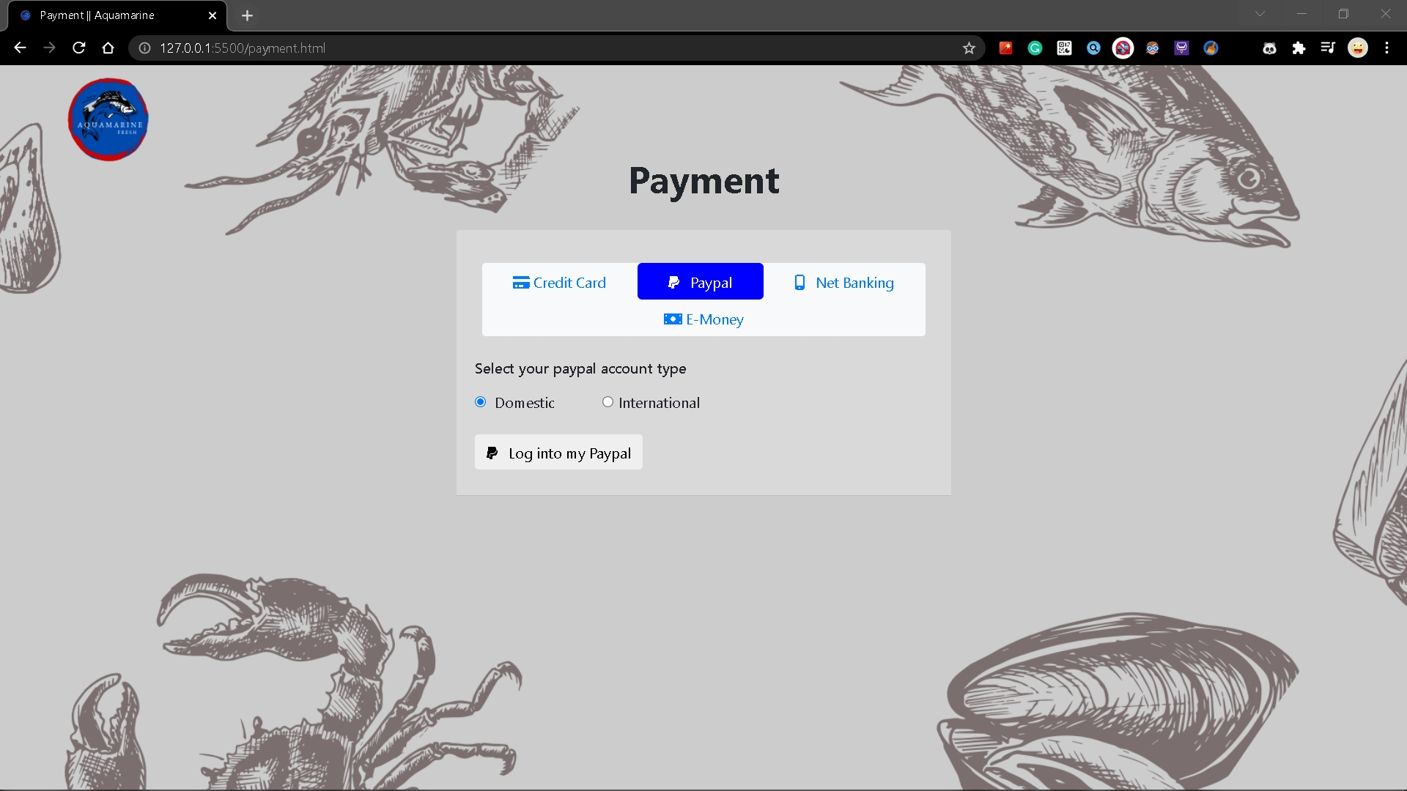
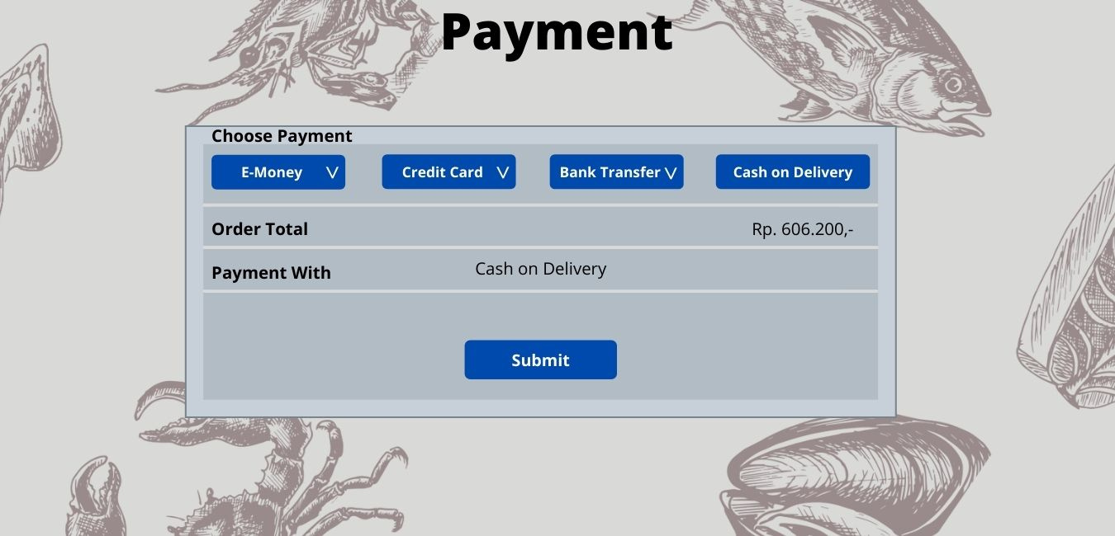
Halaman Payment Paypal
Halaman Payment Paypal
Design
Web
Terdapat logo dikiri atas
Terdapat perbedaan layout dengan design
Order total dihapus
Pilihan COD diganti Paypal
Terdapat pilihan Paypal Account Type
Button Submit diubah menjadi Log into my Paypal

Slide 18
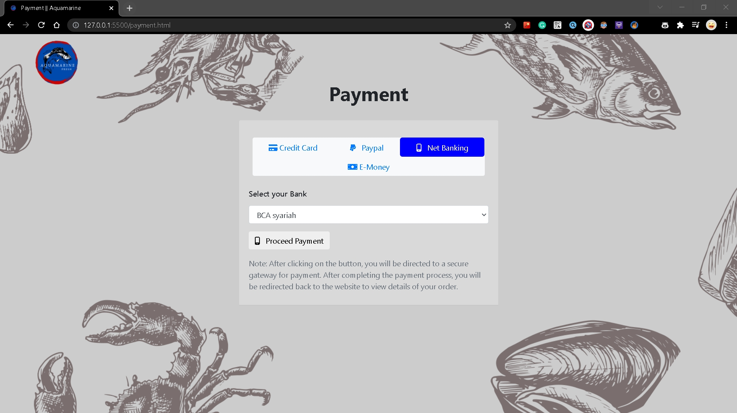

Halaman Payment Net Banking
Design
Web
Terdapat logo dikiri atas
Terdapat perbedaan layout dengan design
Order total dihapus
Pilihan Bank Transfer diubah nama menjadi Net Banking
Button Submit diubah menjadi Proceed Payment
Terdapat text berisi Note

Slide 19
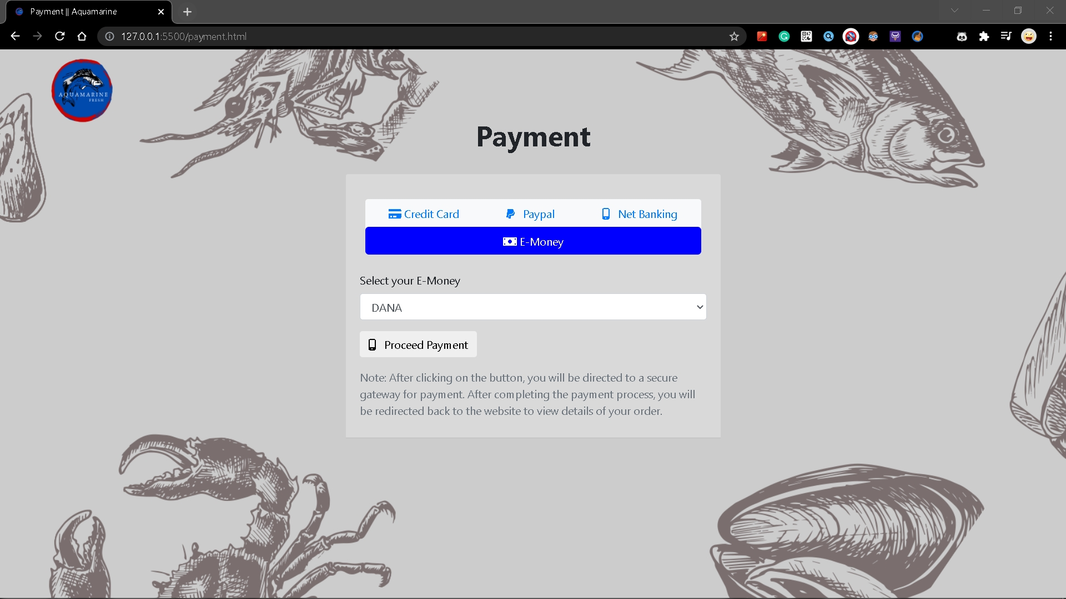
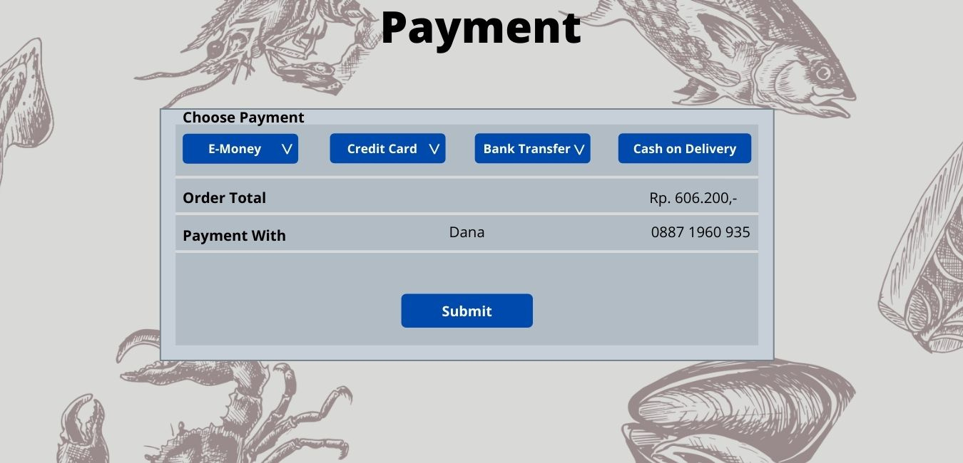
Halaman Payment E-Money
Design
Web
Terdapat logo dikiri atas
Terdapat perbedaan layout dengan design
Order total dihapus
Button Submit diubah menjadi Proceed Payment
Terdapat text berisi Note

Slide 20
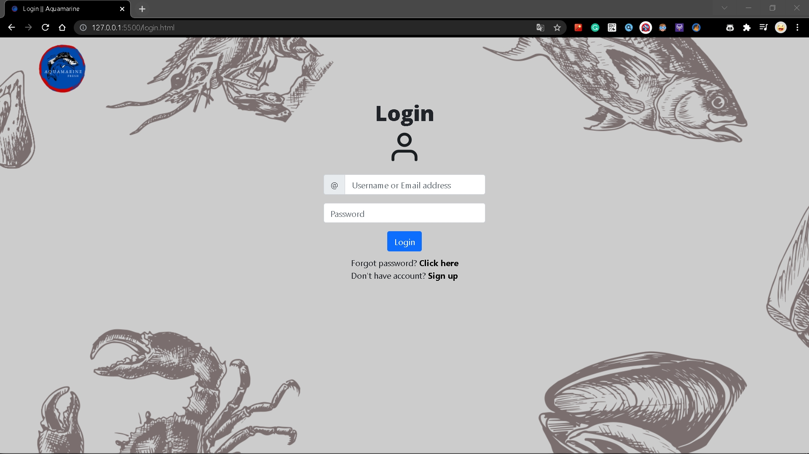
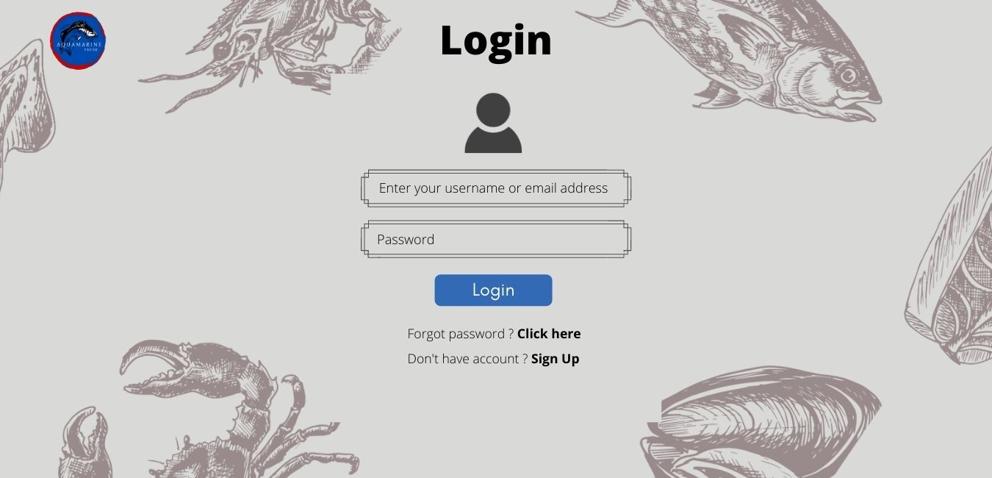
Halaman Login
Design
Web
Terdapat perbedaan layout dengan design yaitu dibagian input boxnya

Slide 21
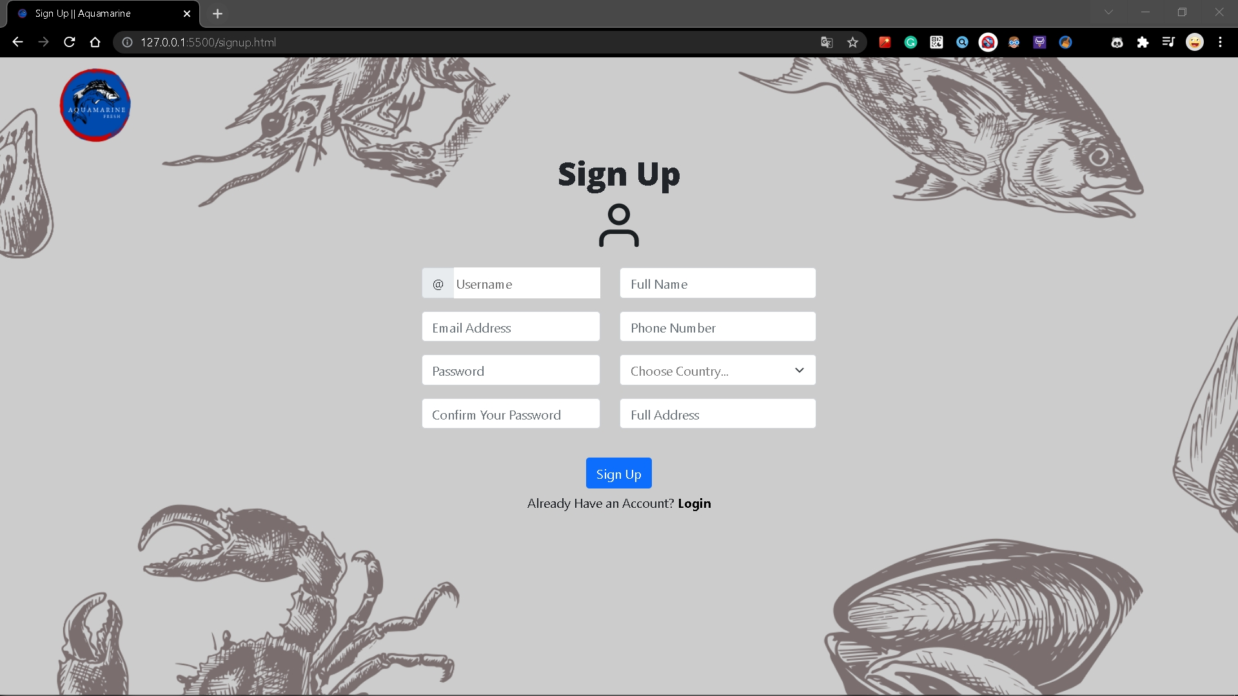
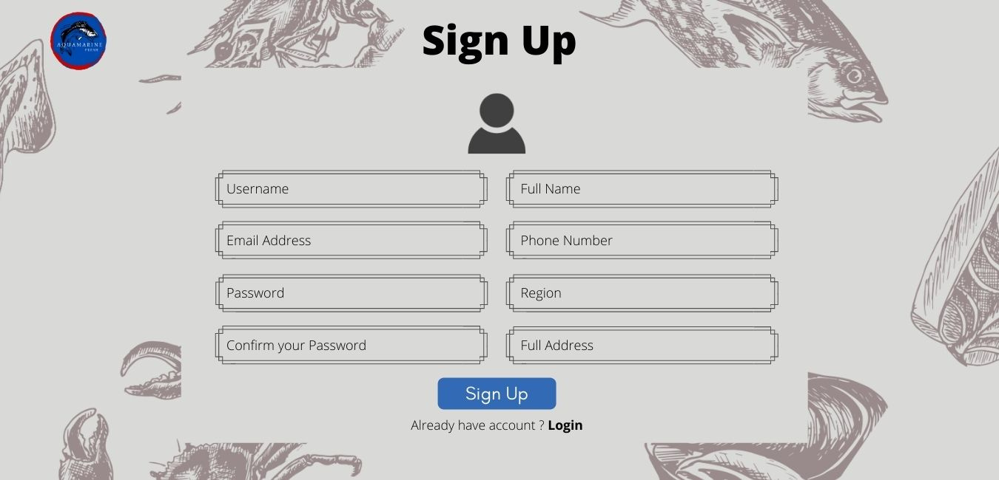
Halaman Sign Up
Design
Web
Terdapat perbedaan layout dengan design yaitu dibagian input boxnya
Region diubah menjadi Choose Country

Slide 22
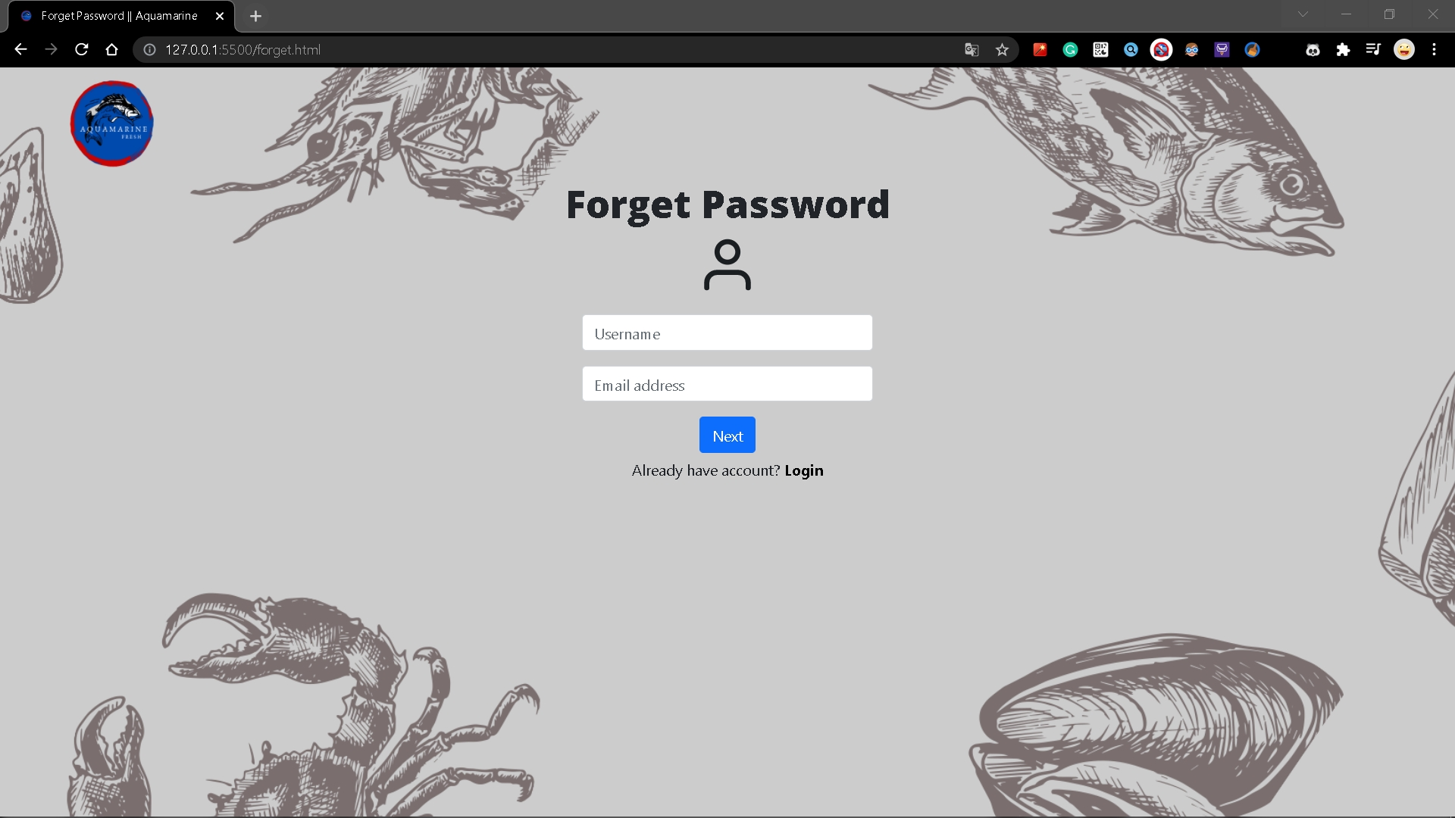
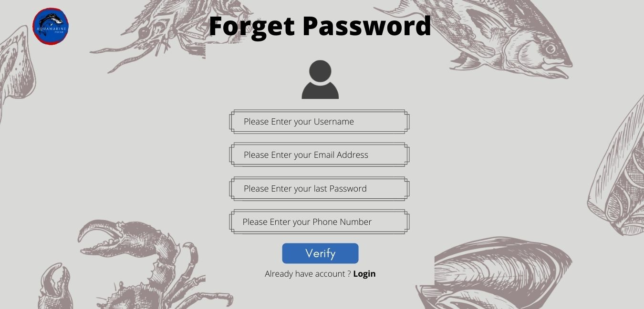
Halaman Forget Password 1
Design
Web
Last Password dan Phone Number dihapus
Button Verify diubah menjadi Next
Perbedaan layout pada input box

Slide 23
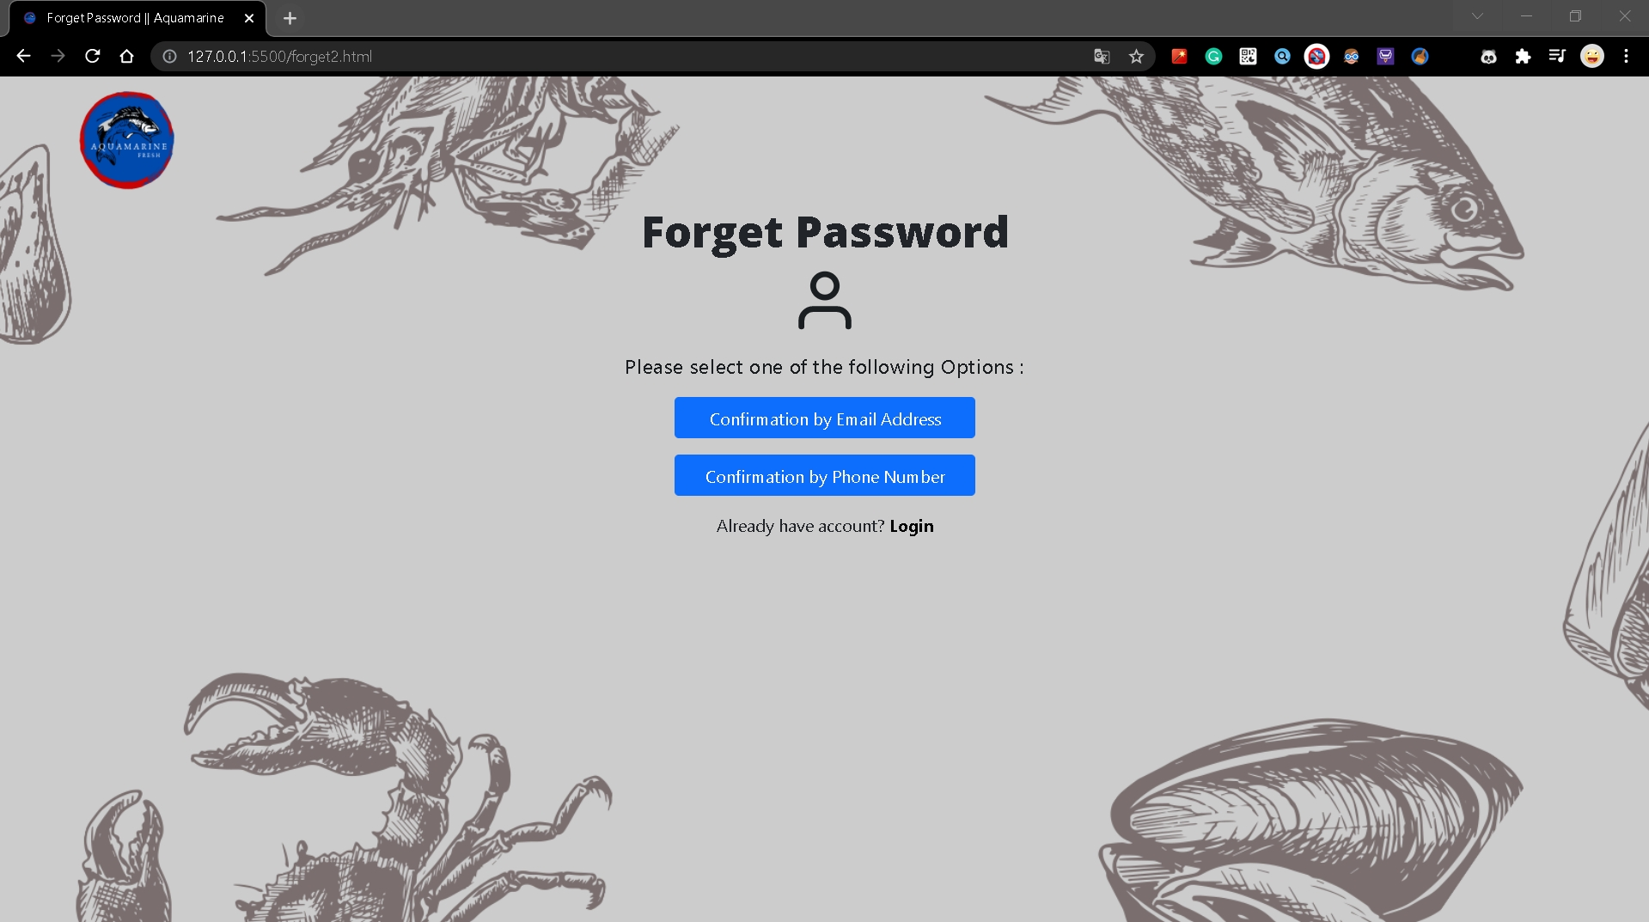
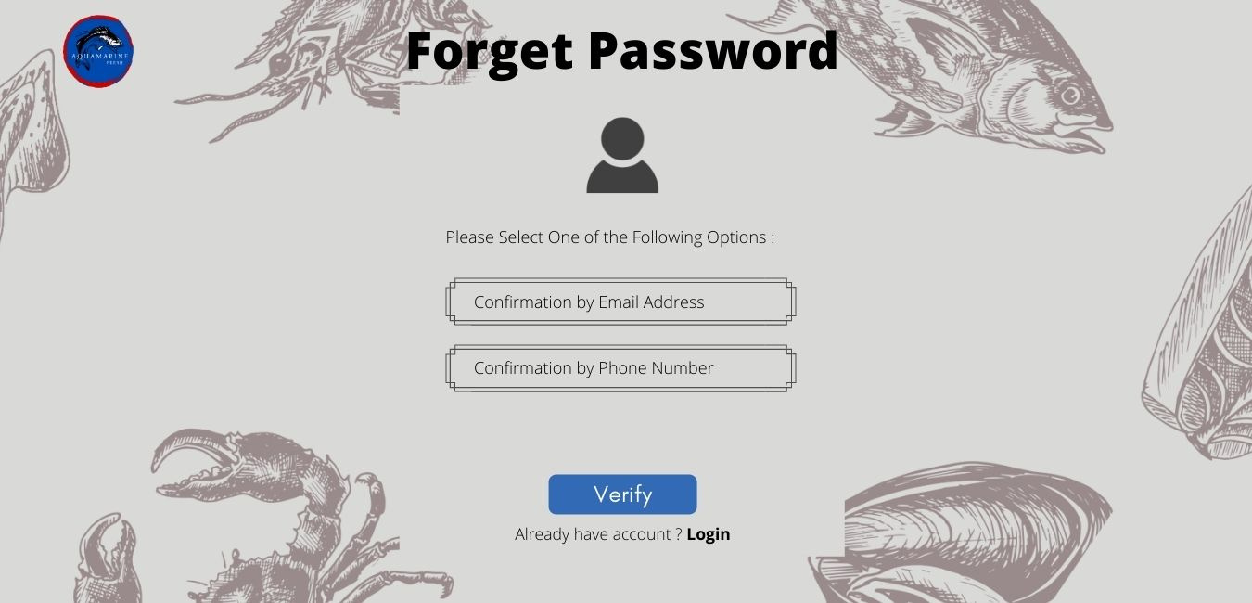
Halaman Forget Password 2
Design
Web
Pada Choose Option, diubah menjadi button yang langsung nge link ke page
Button Verify dihapus karena button yang diatas langsung nge link ke page

Slide 24
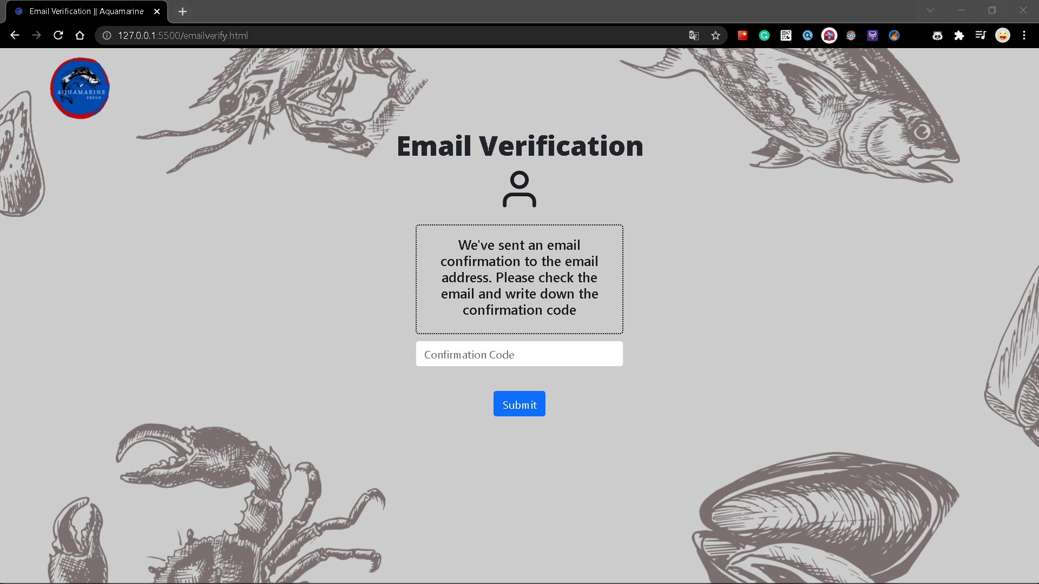
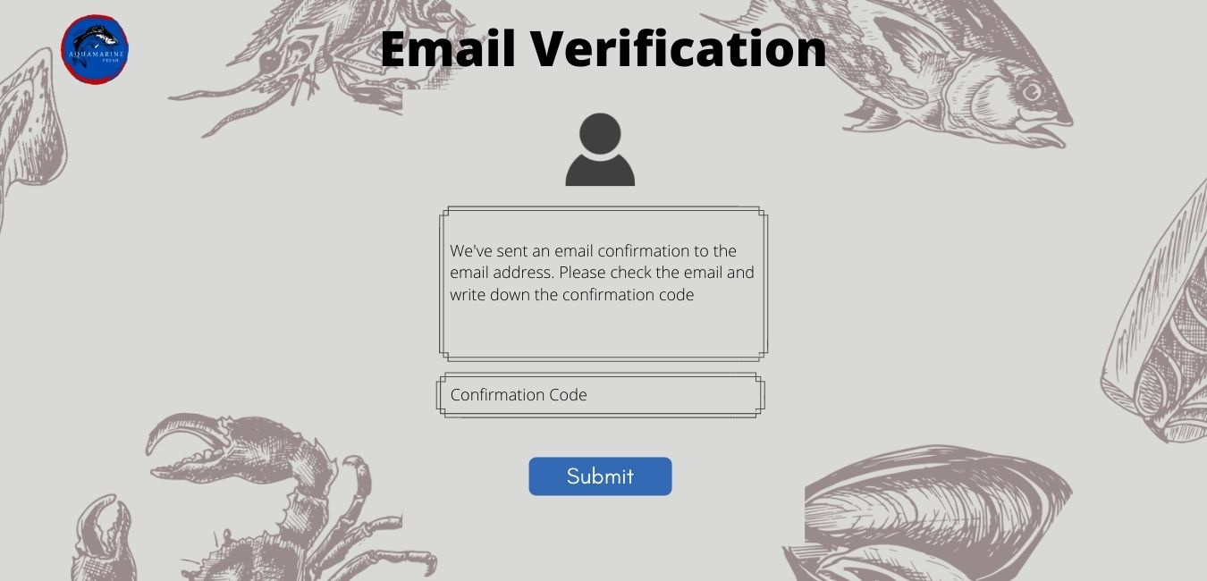
Halaman Email Verification
Design
Web
Perbedaan layout pada input box
Button Submit diubah dari nge link ke Home menjadi ke Change Password

Slide 25
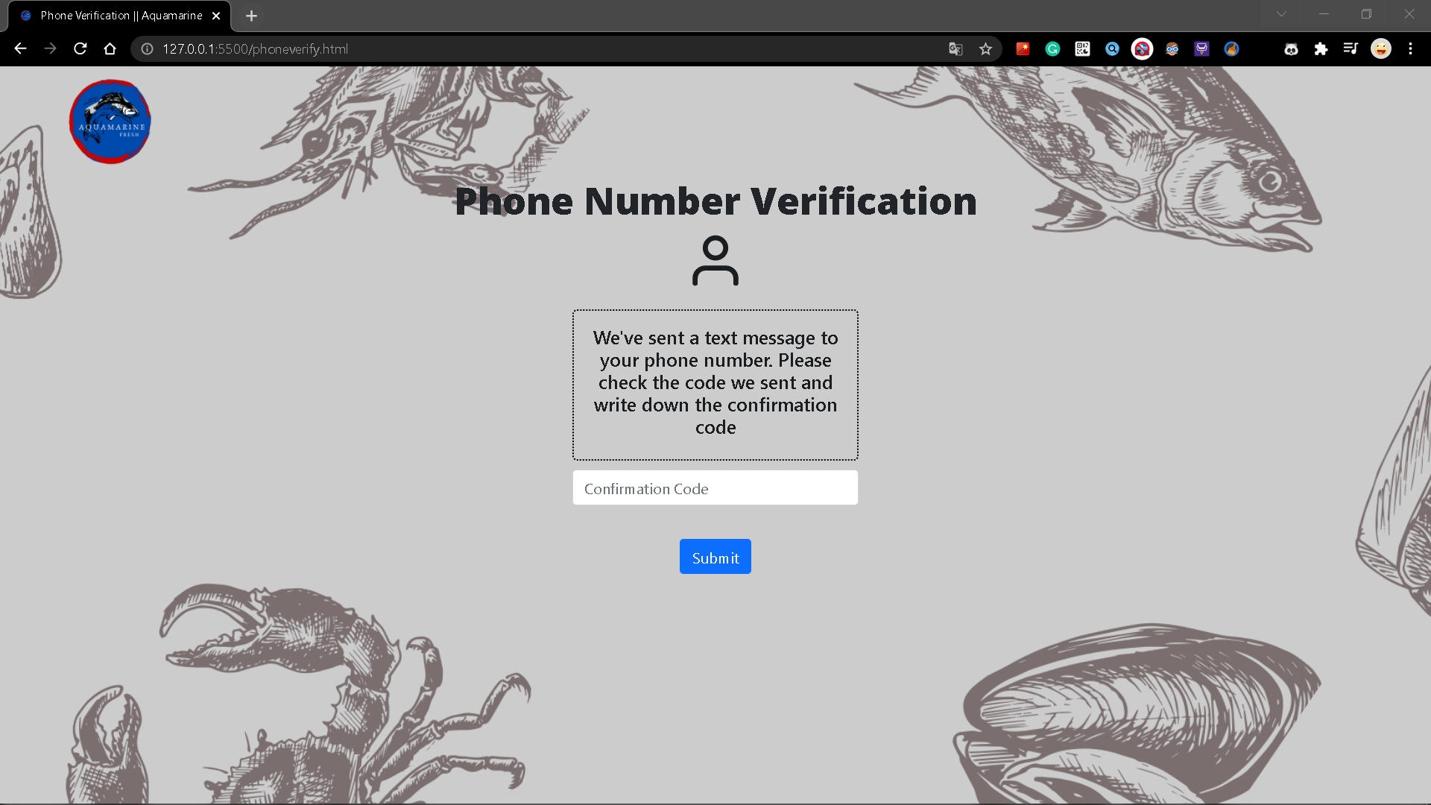
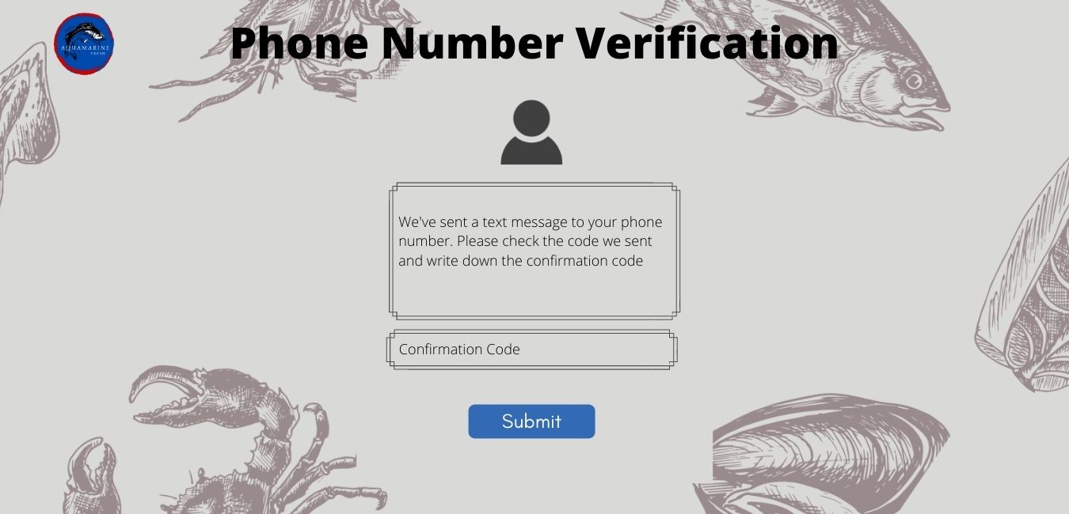
Halaman Phone Verification
Design
Web
Perbedaan layout pada input box
Button Submit diubah dari nge link ke Home menjadi ke Change Password

Slide 26

Halaman Change Password

Slide 27
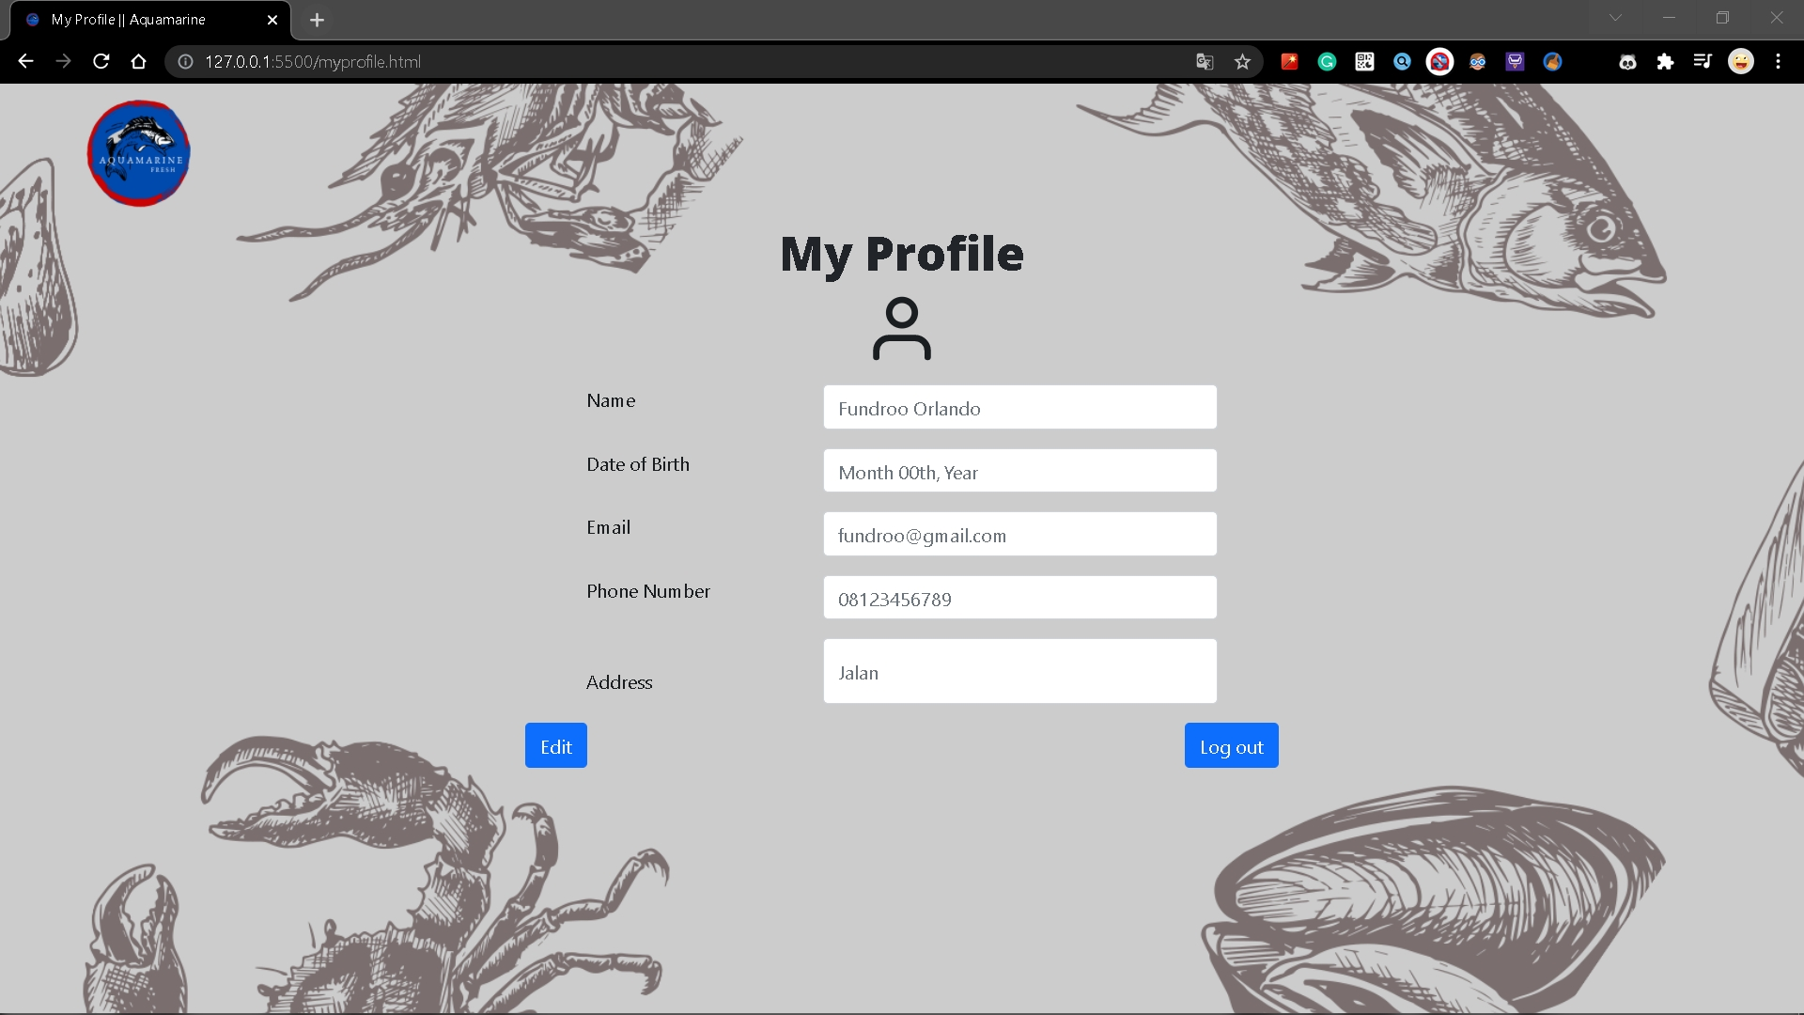
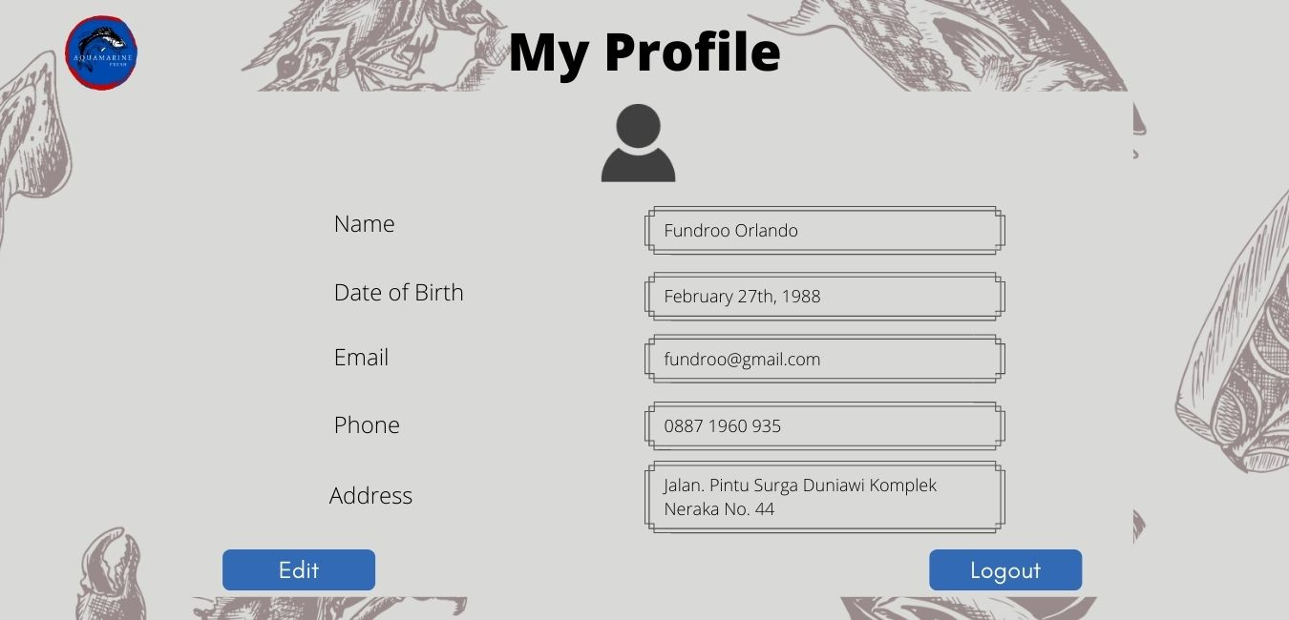
Halaman My Profile
Design
Web
Perbedaan layout pada box

Slide 28
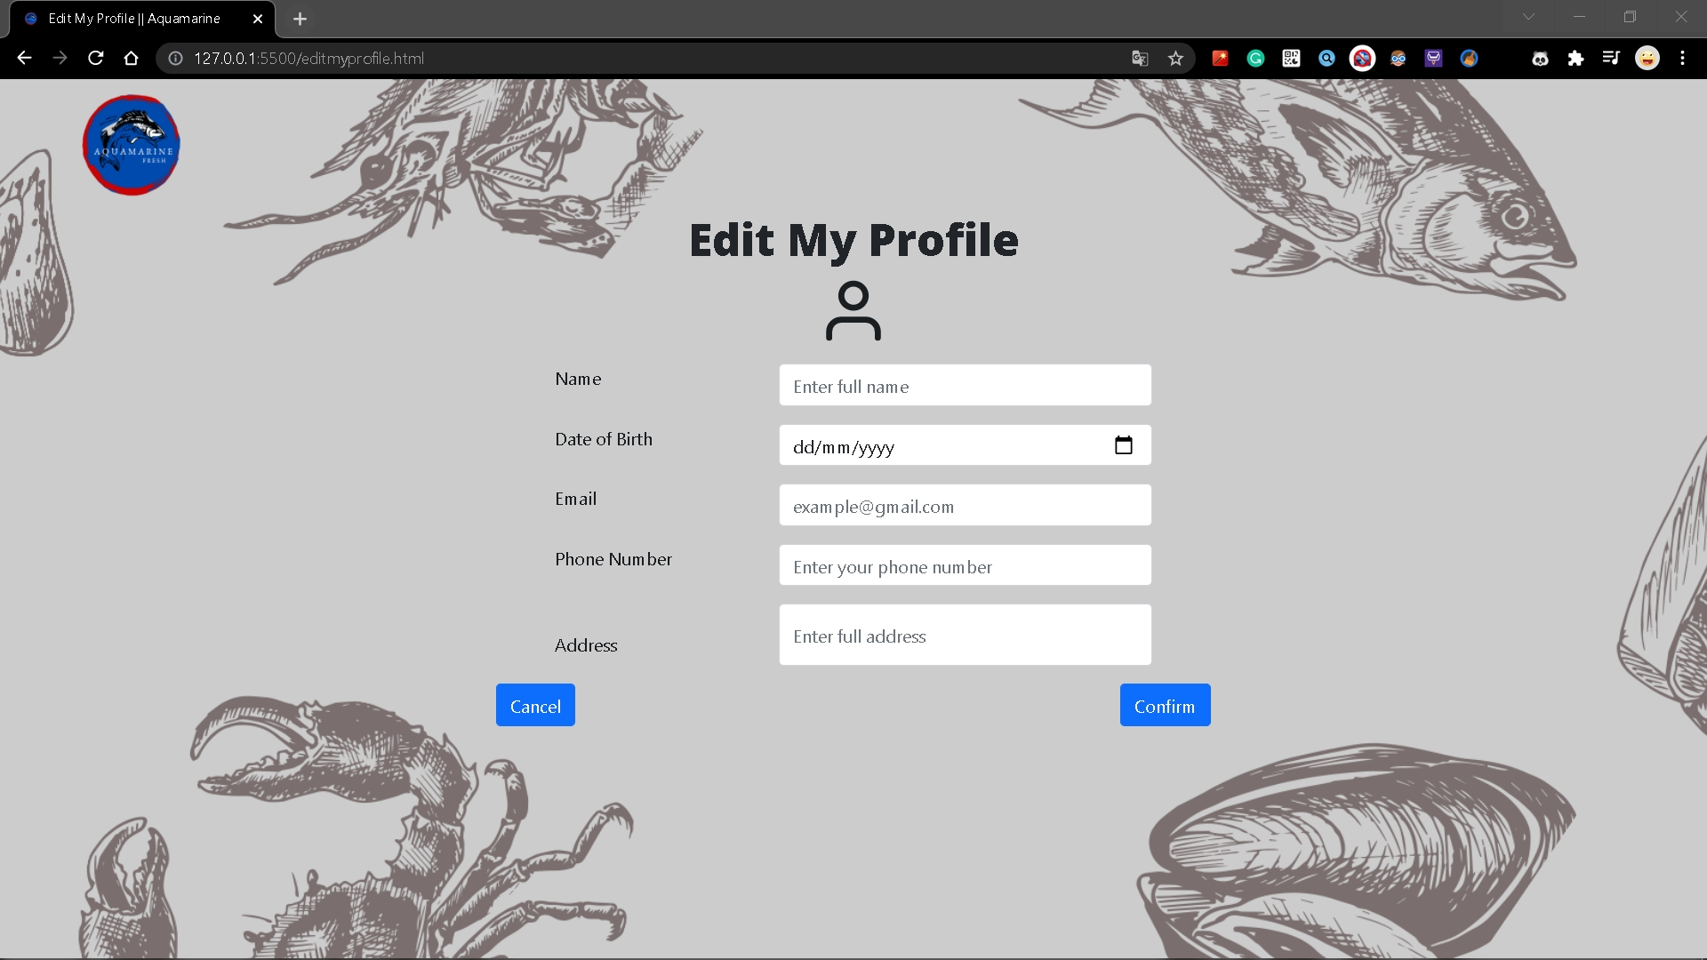
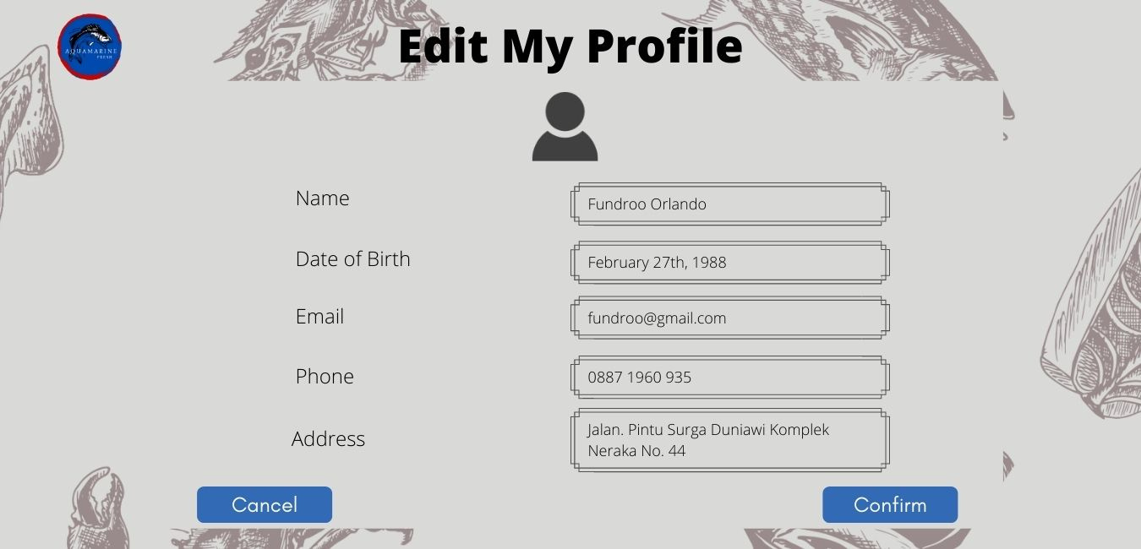
Halaman Edit My Profile
Design
Web
Perbedaan layout pada input box

Slide 29

02
alur proses perpindahan halaman

Slide 30

NAVIGATION BAR
LOGO
01
Click HOME
to HOME section
Click CATEGORIES
to CATEGORIES section
Click PRODUCTS
to PRODUCTS section
02
Click Logo
back to Home
NAVIGATION BAR
Click ABOUT US
to ABOUT US section
Click GALLERY
to GALLERY section
Click CONTACT US
to CONTACT US section
03
SEARCH BAR
04
Click Search
type to Search Something

Slide 31




05
06
CART
PROFILE
else
choose My Profile or Wish List or Logout
if (My Profile) then
to My Profile (new page)
else if (Wish List) then
to Wish List (new page)
else
return to Home
Click Profile icon
if (haventLogin()) then
choose Login or Sign Up
if (Login) then
to Login (new page)
else
to Sign Up (new page)
Click Cart icon
to Cart (new page)
MENU BAR (RESPONSIF)
SLIDESHOW
07
08
Click Menu Bar
show Navigation Bar
Click Slideshow
to Products List (new pages)
if (clickNextIcon) then
to New Slideshow
SEE WHAT’S NEW
Click See What’s New
to Products section

Slide 32

PRODUCTS
09
ABOUT US
10
Click Product
to Product Details (new page)
Click See Other Product
to Products List (new pages)
Click on Map
Slide Map Location
CONTACT US
PRODUCT LIST
11
Click Search
type to Search Something
Click Product
to Product Details
Click Love Icon
Change color to red
add to Wish List
12
Click on Instagram
Link to Instagram Page
Click on Email
Mail to Email Address

Slide 33

PRODUCT LIST
PRODUCT DETAILS
13
Click Search
type to Search Something
Click -
Quantity decrease
Click +
Quantity increase
14
Click Cart
add to Cart
Increase Your Cart
Click Your Cart
to Cart (new page)
PRODUCT DETAILS
CART
15
Click on Product
to Product Details
Click on Love Icon
add to Wish List
Click X Icon
remove from Cart
16
Click Add to Cart
add to cart
Click Buy Now
to Checkout (new page)

Slide 34
CART
CART
17
18
Click Quantity Box
adjust Quantity
Click Checkout
to Checkout (new page)
Click Wish List
to Wish List (new page)
Click Continue Shopping
to Products List (new page)
WISH LIST
WISH LIST
Click Product
to Product Details (new page)
Click + Icon
add to Cart
Click X Icon
remove from Wish List
19
20
Click Quantity Box
adjust Quantity
Click Add All to Cart
add to Cart

Slide 35
CHECKOUT
PAYMENT
Click Change Information
to Edit My Profile (new page)
Click Checkout
if (haventChoosePayment) then
to Payment (new page)
else to Checkout (new page)
Click Choose Payment
to Payment (new page)
22
21
Click Credit Card
type your Card Owner Name
type your Card Name
type Expiration Date
type CVV
click Confirm Payment
to Checkout (new page)
PAYMENT
PAYMENT
23
24
Click PayPal
choose PayPal Account Type
click Log Into My PayPal
pay from your PayPal Application
Click Net Banking
choose Bank
click Proceed Payment
pay from your Net Banking Application

Slide 36
PAYMENT
25
LOGIN
Click E-Money
choose E-Money Type
click Proceed Payment
pay from your E-Money Application
26
Click Username or Email Address
type your Username or Email Address
Click Password
type your Password
SIGN UP
LOGIN
Click Username
Type your Username
Click Email Address
type your Email Address
Click Password
type your Password
Click Confirm your password
Type your password
27
28
Click Login
back to Home
Click Click here
to Forget Password (new page)
Click Sign Up
to Sign Up (new page)

Slide 37
SIGN UP
SIGN UP
Click Full Name
type your Name
Click Phone Number
type your Phone Number
Click Choose Country
choose Country
Click Full Address
type your Address
Click Sign Up
to Login (new page)
Click Login
to Login (new page)
29
30
FORGET PASSWORD (1)
FORGET PASSWORD (1)
31
32
Click Enter your username
type your Username
Click Enter your email address
type Something
Click Next
To Confirmation Page (new page)
Click Login
To Login (new page)

Slide 38
33
34
FORGET PASSWORD (2)
FORGET PASSWORD (2)
Choose Confirmation by Email Address or Confirmation by Phone Number
if (Confirmation by Email Address) then
confirmation code will be send by Email
to Email Verification (new page)
else if (Confirmation by Phone Number) then
confirmation code will be send by Message
To Phone Verification (new page)
Click Login
to Login (new page)
PHONE NUMBER VERIFICATION
EMAIL VERIFICATION
35
36
Click Confirmation Code
type the code
Click Submit
to Change Password (new page)
Click Confirmation Code
type the Code
Click Submit
to Change Password (new page)

Slide 39

CHANGE PASSWORD
MY PROFILE
37
38
Click New Password
type your New Password
Click Confirm New Password
type your New Password
Click Submit
to Login (new page)
Click Edit
to Edit My Profile (new page)
Click Log Out
back to Home
profile will be log out
EDIT MY PROFILE
39
Click box
type something
Click Cancel
back to My Profile (new page)
Click Confirm
back to My Profile (new page)
My Profile changed
AQUAMARINE

Slide 40


Thank You

